Slide 1
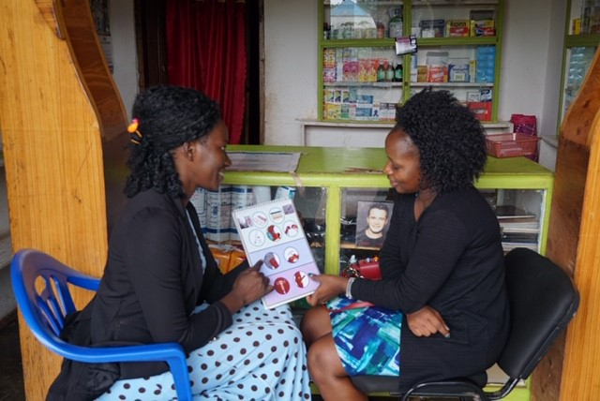


Pharmacies and Drug Shops
Expanding contraceptive choice and access in the private sector.
Notes:
This brief describes the importance of these outlets for providing commodities and information, and outlines key issues for planning and implementing programs to support pharmacy and drug shop staff. While many pharmacies and drug shops already provide family planning, this high-impact practice focuses on how to strengthen and improve these services and their impact.
Photo credit: Leigh Wynne, FHI 360
REVISED:4/23

Slide 2
Overview
What is a HIP?
HIP Categories
Partnership
Introduction to the High Impact Practices (HIPs)
PART
PART
Background
Theory of Change
Why is this practice important?
What is the Impact?
Recommended Indicators
Pharmacies and Drug Shops
Implementation Tips
Priority Research Questions
Tools & Resources
Extra Slides
Notes:
Thank you for using this slide deck! This is a product derived from the HIP brief to assist you in presenting to a variety of audiences. Instructions and additional resources are included in the notes of each slide for your convenience. There is a wealth of information and resources in the “Notes” section of each slide.
This presentation is divided in three parts: an Introduction to the High Impact Practices (HIPs) in Family Planning, Pharmacies and Drug Shops, and Extra Slides.
The logo for your organization or ministry may be added to these slides. The web addresses provided in the “Notes” section of each slide can be copied and pasted into your web browser.

Slide 3



High Impact Practices in Family Planning (HIPs) are…
Evidence-based family planning practices
Vetted by experts against specific criteria
Documented in an easy-to-use format
Notes:
High Impact Practices (HIPs) are a set of evidence-based family planning practices vetted by experts against specific criteria and documented in an easy-to-use format.
The High Impact Practices in Family Planning (HIPs) were first created in 2010 after a survey of FP stakeholders revealed little consensus for “what works” in international FP programming. A small group of leaders in FP were brought together with the task of identifying a short list of HIPs that if implemented at scale would help countries address the unmet need for FP and thereby increase national contraceptive prevalence.
HIPs are identified based on demonstrated magnitude of impact on contraceptive use and potential application in a wide range of settings. Consideration is also given to other relevant outcome measures including unintended pregnancy, fertility, or one of the primary proximate determinants of fertility (delay of marriage, birth spacing, or breast feeding). Evidence of replicability, scalability, sustainability, and cost-effectiveness are also considered.
For more information, please copy and paste this link into your web browser to see this video: https://www.youtube.com/watch?v=N6V0gfl-V3k&ab_channel=KnowledgeSUCCESS
A 2-pager overview of the HIPs is available in an online and a downloadable PDF format here (copy and paste this link into your web browser): https://www.fphighimpactpractices.org/high-impact-practices-in-family-planning-list/

Slide 4
HIPs address the full spectrum of FP programming
Enabling Environment
Service Delivery
Social and Behavioral Change
PART
Address systemic barriers that affect an individual’s ability to access family planning information & services. 8 briefs
Improve the availability, accessibility, acceptability, and quality of family planning services. 8 briefs
Influence knowledge, beliefs, behaviors, and social norms associated with family planning.
7 briefs
Enhancements
Approaches used in conjunction with HIPs to maximize the impact of HIP implementation or increase the reach. 4 briefs
Notes:
There are three categories of HIPs: Enabling Environment, Service Delivery and Social and Behavioral Change. Pharmacies and Drug Shops a Service Delivery HIP. This information came from the HIP List (copy and paste this link into your web browser): https://www.fphighimpactpractices.org/high-impact-practices-in-family-planning-list/
A HIP Enhancement is a tool or approach that is not a standalone practice, but it is often used in conjunction with HIPs to maximize the impact of HIP implementation or increase the reach and access for specific audiences. The intended purpose and impact of enhancements are focused and, therefore the evidence-based and impact of an enhancement is subjected to different standards than a HIP.
For more information about the HIP Categories and Enhancements, please copy and paste this link into your web browser: https://www.fphighimpactpractices.org/high-impact-practices-in-family-planning-list/
Here are a few examples of HIPs from each category:
Service Delivery:
Immediate Postpartum Family Planning
Mobile Outreach Services
Postabortion Family Planning
Enabling Environment:
Domestic Public Financing
Educating Girls
Supply Chain Management
Social and Behavior Change:
Community Group Engagement
Digital Health for SBC
Mass Media
Enhancements:
Digital Health for Systems
Adolescent-Responsive Contraceptive Services
Family Planning Vouchers
All HIPs are Available in English, Spanish, French, and Portuguese.

Slide 5
HIP Partnership
The Technical Advisory Group (TAG) is made up of 25 experts in family planning, including representatives from the co-sponsors.
The Co-sponsors include the following organizations:
Notes:
The High Impact Practices in Family Planning (HIPs) are supported by over 65 organizations. These organizations play a vital role in developing, reviewing, disseminating, and implementing HIPs in family planning.
The HIPs partnership includes various structures to ensure HIP products are developed, kept up to date, and disseminated widely. These include:
Co-sponsors – Serve as the secretariat for the HIPs.
Partners – Contribute to key HIP products and endorse the HIPs.
Technical Advisory Group – Ensure high technical quality of key HIP products and approve HIP brief and SPG concepts for development.
P&D Team – Support the production and dissemination (P&D) of HIP products.
Technical Expert Groups – Write new HIP briefs and ensure they are up-to-date.
For more information about the HIP Partnership, please copy and paste this link into your web browser: https://www.fphighimpactpractices.org/partnership-structure/

Slide 6
High Impact Practice
Train and support pharmacies and drug shops to provide family planning information and a broad range of quality contraceptive methods.
Notes:
This brief describes the importance of these outlets for providing commodities and information, and outlines key issues for planning and implementing programs to support pharmacy and drug shop staff. While many pharmacies and drug shops already provide family planning, this high-impact practice focuses on how to strengthen and improve these services and their impact.
For more information about Service Delivery HIPs, please copy and paste this link into your web browser to visit this matrix of tools developed by IBP/WHO: https://www.fphighimpactpractices.org/ibp-who-matrix/
These tools can be used in conjunction with Service Delivery HIPs.
Available in online and downloadable PDF format.
Did you know that we have a webinar recording and downloadable PDF presentation about this HIP? Please copy and paste this link into your web browser to visit: https://www.fphighimpactpractices.org/drug-shops-and-pharmacies-sources-for-family-planning-commodities-and-information-webinar/
This webinar contains recent implementation successes in several country contexts.
Presenters include:
John Stanback, FHI 360, Facilitator
Mario Philip Festin, WHO
Pamely Riley, Abt Associates
Tracy Orr, FHI 360
Frederick Mubiru, FHI 360 Uganda

Slide 7
Background
Private sector pharmacies and drug shops are often the first line of health care in low- and middle-income countries, particularly for many underserved populations and especially in rural areas that have very few private or public clinics.
Evidence shows that with training and support, pharmacy and drug shop staff can facilitate the use of a broad range of modern contraception, especially in areas where the unmet need is high, access to family planning services is poor, and health worker shortages and other barriers prevent women, men, and youth from accessing family planning services.
Notes:
Private sector pharmacies and drug shops are often the first line of health care in low- and middle-income countries, particularly for many underserved populations and especially in rural areas that have very few private or public clinics.
Pharmacies and drug shops, with their convenience, anonymity, and cost savings (compared to private physicians), are an essential source of health services, products, and information that is particularly important in the context of “high maternal mortality and morbidity, poorly stocked clinics, high unmet need for family planning” and critical health-worker shortages.
Despite their popularity and potential, pharmacies and drug shops have often not been considered part of the larger health system; they are typically missing from countries’ health strategies, policies and regulation, and monitoring.
Evidence shows that with training and support, pharmacy and drug shop staff can facilitate the use of a broad range of modern contraception, especially in areas where the unmet need is high, access to family planning services is poor, and health worker shortages and other barriers prevent women, men, and youth from accessing family planning services.
For more information, please copy and paste this link into your web browser to reference the “Background” section on the HIP brief: https://www.fphighimpactpractices.org/briefs/drug-shops-and-pharmacies/

Slide 8
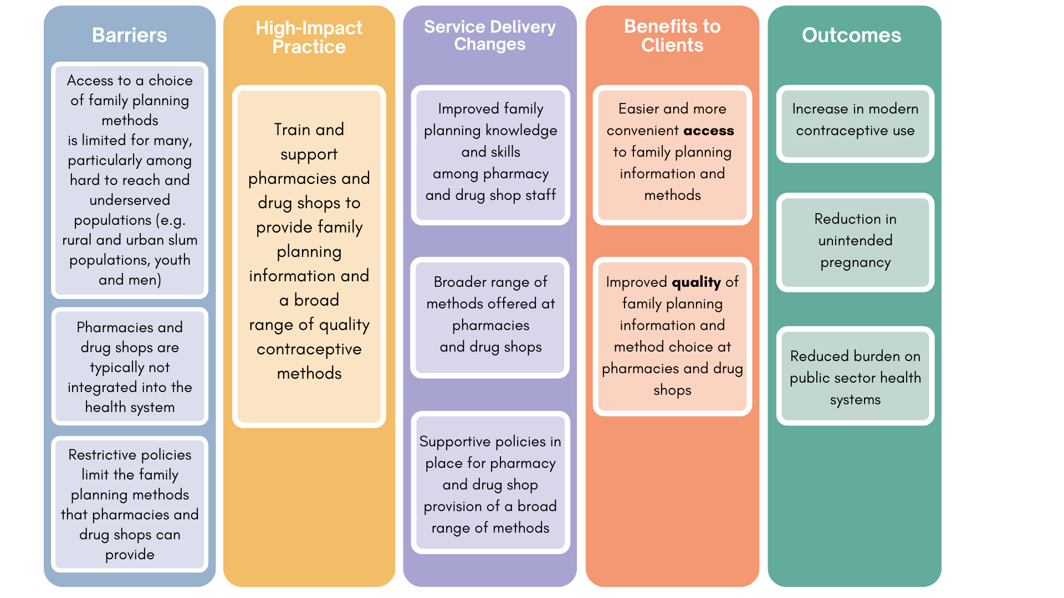
Theory of
Change
BACKGROUND
Notes:
View Figure 1 in the HIP brief (copy and paste this link into your web browser): https://www.fphighimpactpractices.org/briefs/drug-shops-and-pharmacies/

Slide 9
Why is this practice important?
Pharmacy and drug shop staff advise clients and treat a variety of ailments in many countries, providing an opportunity to reach existing and potential family planning clients.
Besides providing information on family planning, pharmacy and drug shop staff can safely provide a wide range of methods.
Notes:
Pharmacy and drug shop staff advise clients and treat a variety of ailments in many countries, providing an opportunity to reach existing and potential family planning clients.
Both pharmacies and drug shops are particularly important in countries where health system infrastructure is weak, overburdened, poorly distributed, or understaffed.
Training and support for pharmacy and drug shop staff can strengthen these widely used services to ensure that users receive quality services.
Besides providing information on family planning, pharmacy and drug shop staff can safely provide a wide range of methods.
Female condoms are also an appropriate method for distribution at drug shops and a study in Nigeria found that both male and female condoms were mostly procured from patent medicine dealers and pharmacy shops.
Pharmacies and drug shops are the main source for obtaining oral contraceptives (OCs) and emergency contraception (EC) in many countries.
A significant proportion of women rely on pharmacies and drug shops for injectable contraception, including both through intramuscular (IM) and subcutaneous (SC) administration.

Slide 10
Why is this practice important?
Drug shops, in particular, remove barriers to family planning access in underserved areas.
Supporting and strengthening pharmacies and drug shops is an effective way to complement the public sector and expand the impact of a health system.
Notes:
Drug shops, in particular, remove barriers to family planning access in underserved areas.
Studies show that clients often find private providers, such as drug shop operators, more acceptable than public sector clinics.
Pharmacies and drug shops offer clients proximity, expediency, flexibility in operating hours, and responsiveness to the client’s needs compared to public sector clinics.
Supporting and strengthening pharmacies and drug shops is an effective way to complement the public sector and expand the impact of a health system.
This can help to alleviate the burden on the public sector and expand access to services.
Implementing these guidelines requires policy change, which has happened in a number of countries.
Recommendations for family planning in the WHO self-care guidance include making oral contraceptives available over-the-counter without a prescription and making self-administered injectable contraception available.

Slide 11
What is the Impact?
ACCESS:
Pharmacies and drug shops are an important source of supply for a range of contraceptives in many countries.
Pharmacies and drug shops are popular for short-acting contraceptive users, including hard-to-reach or underserved populations, such as unmarried women, males, and youth, due to convenience, cost, and confidentiality.
Notes:
ACCESS:
Pharmacies and drug shops are an important source of supply for a range of contraceptives in many countries.
In many countries, around half of pill users and as many as 80% or more of condom users obtained their methods at pharmacies or drug shops, with a growing proportion of injectable users also using these sources.
A study in Uganda found that “almost half of the drug shop clients had switched from other providers, primarily from government health clinics, mostly as a result of more convenient locations, shorter waiting times, and fewer stock-outs in drug shops.”
Pharmacies and drug shops are popular for short-acting contraceptive users, including hard-to-reach or underserved populations, such as unmarried women, males, and youth, due to convenience, cost, and confidentiality.
Young women (often single), who may be stigmatized in traditional family planning outlets, constitute a majority of the women who source their contraception in drug shops and pharmacies in countries with a low modern contraceptive prevalence rate.
Drug shops are convenient for men and boys who may be less willing to go to clinics or pharmacies, especially if they have to travel longer distances.
In countries with low mCPR countries (mCPR < 20%), “over one-third of pharmacy and drug shop clients are youth.”

Slide 12
What is the Impact?
QUALITY:
Training and support improve the quality of family planning services offered by pharmacies and drug shops, thereby improving client satisfaction.
Notes:
QUALITY:
Training and support improve the quality of family planning services offered by pharmacies and drug shops, thereby improving client satisfaction.
With training and supportive supervision, pharmacy and drug shop staff generally provide family planning services safely, reliably, and with greater client satisfaction.
Studies have shown that, after appropriate training, drug shops are more likely to use sharps disposal boxes; give information on side effects of EC; and make referrals to facilities.
Social franchising and social marketing have helped expand the role of private sector pharmacies and drug shops in increasing access to a range of contraceptives, and also play a role in improving skills and quality.
Pharmacies and Drugs Shops is a promising practice.
A promising practice has limited evidence, with more information needed to fully document implementation experience and impact. The advisory group recommends that such promising interventions be promoted widely, provided they are implemented within the context of research and are carefully evaluated in terms of both impact and process.
Social marketing: https://www.fphighimpactpractices.org/briefs/social-marketing/
Social franchising: https://www.fphighimpactpractices.org/briefs/social-franchising/ HIP briefs

Slide 13

Recommended Indicators
Percent of pharmacies and drug shops providing family planning services, including at least three modern methods. The methods should be specific to the country or area where the practice is being implemented.
Percent of pharmacies and drug shops with staff members trained in family planning.
Percent of women/men who received their last method from a pharmacy or drug shop.

Slide 14
Thank You
Continue to the extra slides or access the HIP brief for more information.
Notes:
For more information, please copy and paste this link into your web browser to visit this webpage with a recording of the webinar on Pharmacies and Drug Shops and a downloadable PDF version of the presentation: https://www.fphighimpactpractices.org/briefs/drug-shops-and-pharmacies/

Slide 15
Extra Slides
Implementation Tips
Priority Research Questions
Tools & Resources
Notes:
We have put together a collection of implementation tips for Pharmacies and Drug Shops, in case you have additional time in your meeting. Further information about these tips can be found in the HIP brief.
References from the literature on this HIP can be found here (copy and paste this link into your web browser): https://www.fphighimpactpractices.org/briefs/drug-shops-and-pharmacies/

Slide 16

Implementation Tips
Know the legal, regulatory, and policy environment.
Efforts to expand the role of pharmacies and drug shops should consider whether country policies and regulations are supportive and adequate for expanding access to family planning information and products.

Slide 17
Implementation Tips
Strategically support advocacy to address policy barriers.
Evidence-based advocacy can support changes in policy related to the sale of family planning methods through pharmacies and drug shops, and to support training, accreditation, and regulation.

Slide 18
Implementation Tips
Provide drug shop and pharmacy staff training and support on the family planning methods they offer, including promotional materials for clients and job aids for staff to improve quality of services.
Because pharmacy and drug shop staff often work long hours and can be reticent to attend training sessions, training courses should be as brief as possible at convenient hours, such as in the evening.

Slide 19
Implementation Tips
Promote simple and clear processes for licensing pharmacies and drug shops.
It is important to work with national authorities to seek their input into successful strategies for engagement, continuing education, and monitoring.

Slide 20
Implementation Tips
Formalize and strengthen the linkages between pharmacies and drug shops and the larger health system.
Globally and nationally, efforts should be made to include pharmacy and drug shop provision into family planning guidance, such as service delivery guidelines.
Locally, pharmacy and drug shop staff should be comfortable referring clients to higher level clinical services and should be knowledgeable about what services are available and where.

Slide 21
Implementation Tips
Create a quality assurance or oversight system.
Quality assurance systems are desirable for providing ongoing support to drug shop and pharmacy staff, and can ensure periodic reviews, including use of regular monitoring data.

Slide 22
Implementation Tips
Strengthen pharmacy and drug shop business practices, such as pricing, financing, and supply management, to improve sustainability of services.
Market forces will typically determine pricing, but training should also provide support to pharmacy and drug shop staff to identify the best way to price their products.
Promoting the stocking of generic products can potentially increase cost-efficiency.

Slide 23
Priority Research Questions
What kinds of training, supportive supervision, or other interventions work best to improve family planning knowledge and practice among pharmacy and drug shop staff?
What are the best ways to facilitate effective referrals?
What kinds of training, supportive supervision, or other interventions work best to improve family planning knowledge and practice among pharmacy and drug shop staff?
What are the best ways to facilitate effective referrals?
Notes:
These research questions, reviewed by the HIP technical advisory group, reflect the prioritized gaps in the evidence base specific to the topics reviewed in this brief and focus on the HIP criteria.

Slide 24

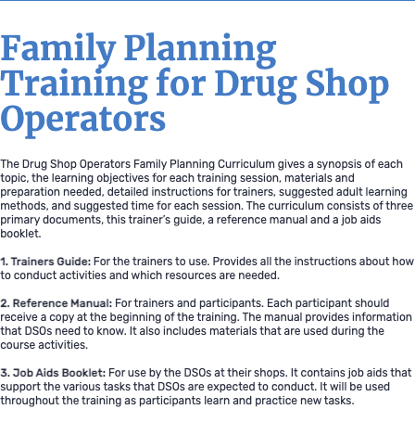
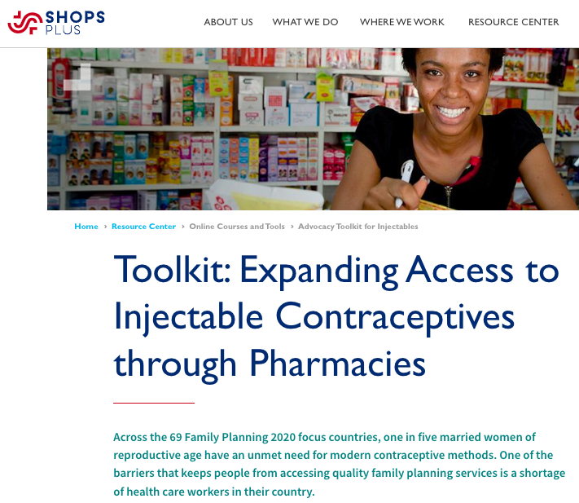
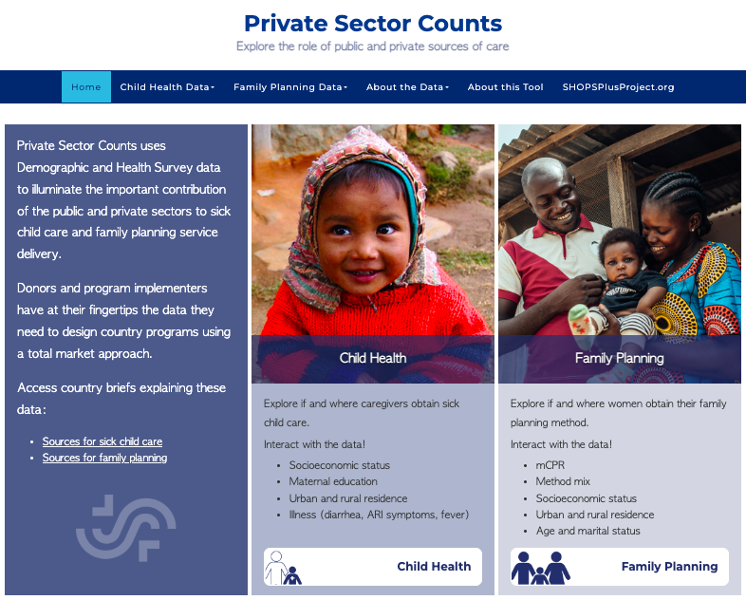
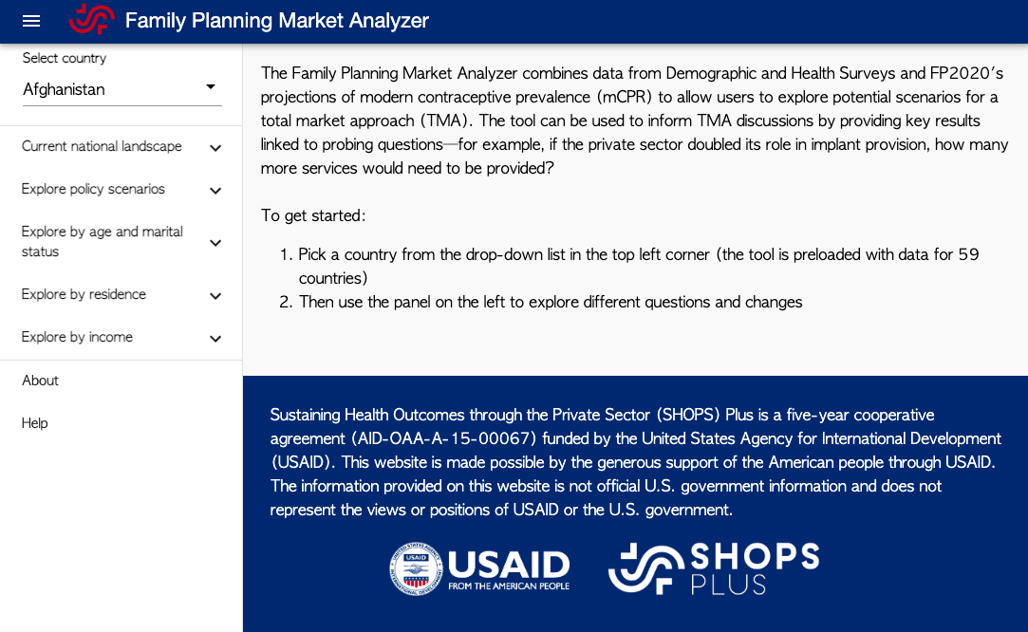
Tools & Resources
Toolkit: Expanding Access to Injectable Contraception through Pharmacies
Drug Shop Operators Family Planning Curriculum
Private Sector Counts
FP Market Analyzer
Notes:
Drug Shop Operators Family Planning Curriculum. Available from: https://toolkits.knowledgesuccess.org/toolkits/cba2i/drug-shop-provision-family-planning
Toolkit: Expanding Access to Injectable Contraception through Pharmacies (SHOPS PLUS). Available from: https://shopsplusproject.org/resource-center/toolkit-expanding-access-injectable-contraceptives-through-pharmacies
Private Sector Counts and FP Market Analyzer are two tools from SHOPS PLUS to understand where women access contraception and help with data visualization to inform advocacy. Available from: https://www.privatesectorcounts.org/ and https://fpmarketanalyzer.org/

Slide 25
fphighimpactpractices.org
Notes:
Subscribe to the HIPs Newsletter here (copy and paste this link into your web browser): https://mailchi.mp/76703a3652c9/hips-newsletter-sign-up
Please visit the five areas of our website to learn more about the HIPs:
HIP Products (copy and paste this link into your web browser): https://www.fphighimpactpractices.org/hip-products/
Resources (copy and paste this link into your web browser): https://www.fphighimpactpractices.org/resources/
Engage (copy and paste this link into your web browser): https://www.fphighimpactpractices.org/engage-with-the-hips/
Overview (copy and paste this link into your web browser): https://www.fphighimpactpractices.org/overview/
About Us (copy and paste this link into your web browser): https://www.fphighimpactpractices.org/partnership-structure/

