Slide 1
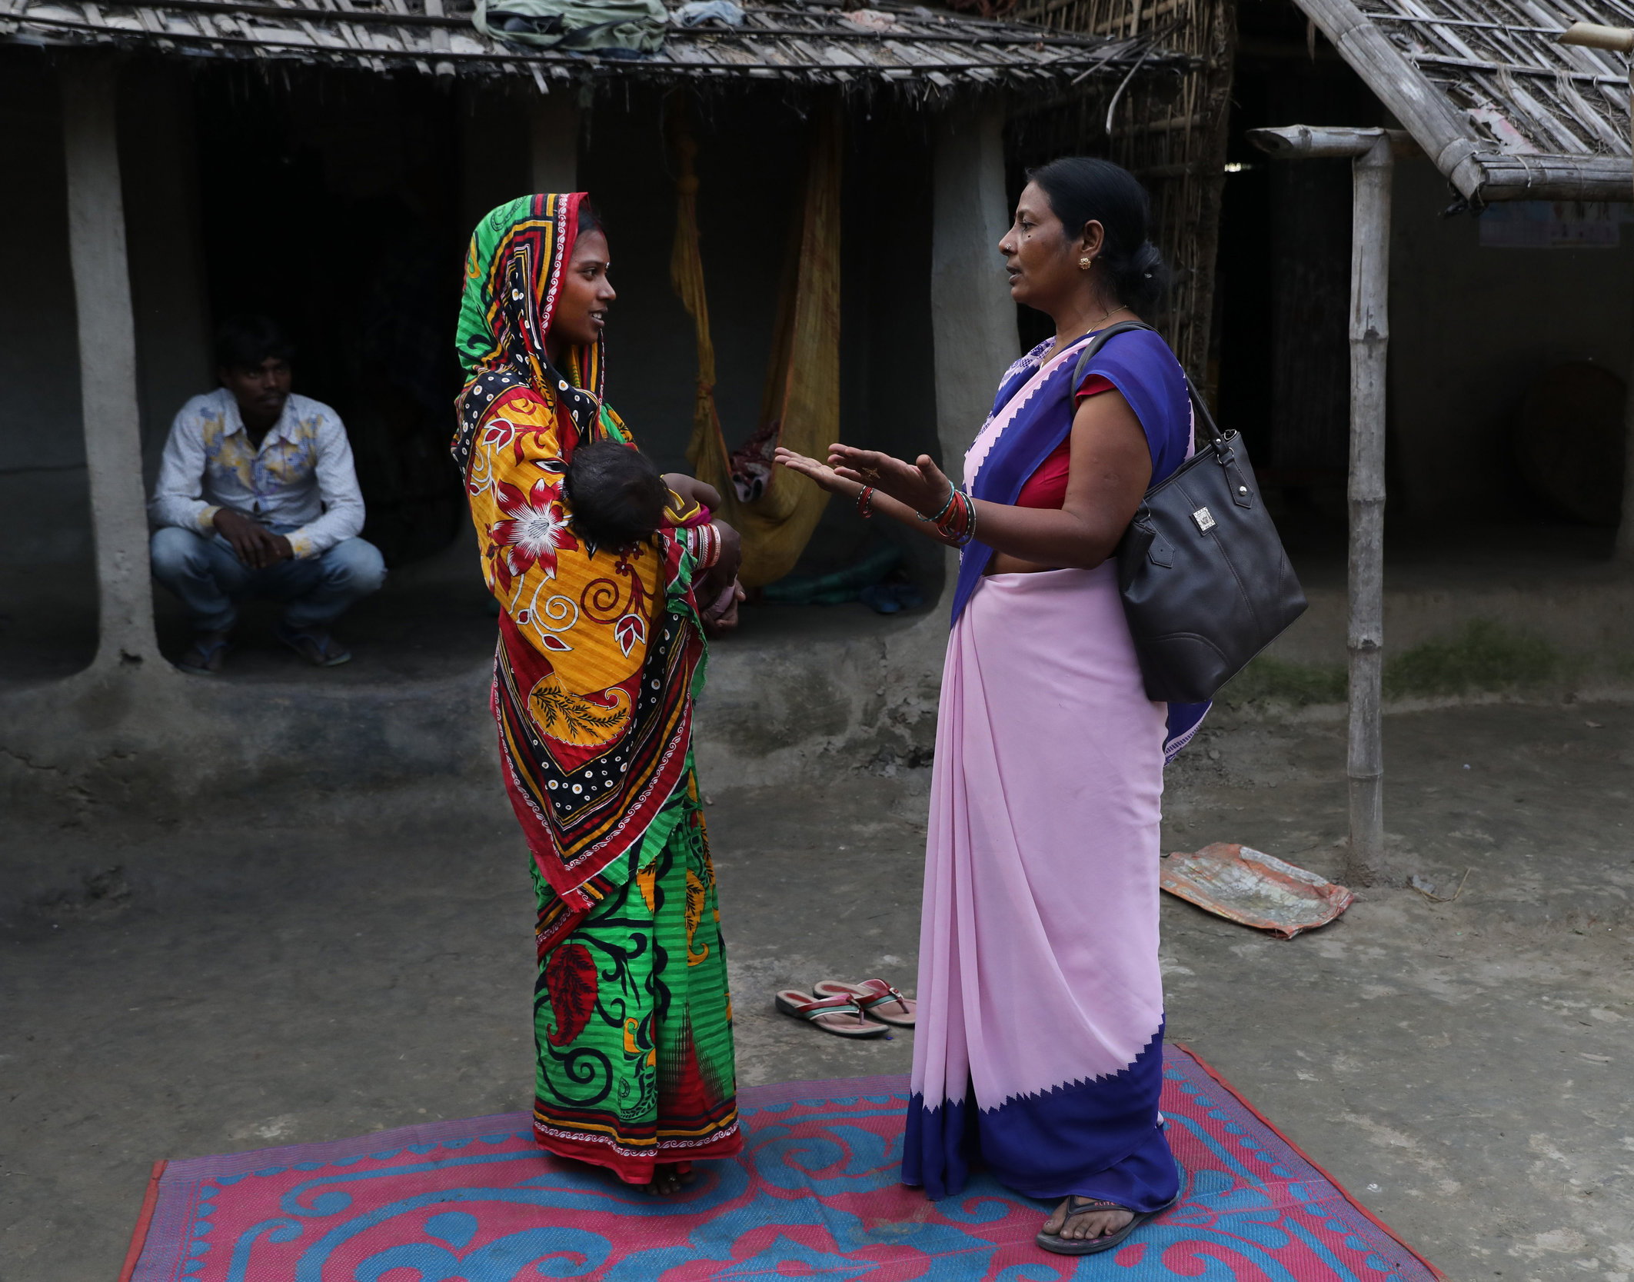


Knowledge, Beliefs, Attitudes, and Self-efficacy
Strengthening an individual’s ability to achieve their reproductive intentions.
Notes:
This HIP brief together with the other two HIP briefs focusing on understanding and addressing behavioral determinants (social norms and couples’ communication) recognizes that factors influencing health behaviors exist on multiple levels, are interrelated, and extend beyond the individual.
Social norms: https://www.fphighimpactpractices.org/briefs/social-norms/
Couples’ communication: https://www.fphighimpactpractices.org/briefs/couple-communication/
Photo credit: Images of Empowerment
REVISED: 3/23

Slide 2
Overview
What is a HIP?
HIP Categories
Partnership
Introduction to the High Impact Practices (HIPs)
PART
PART
Background
Theory of Change
Why is this practice important?
Interventions
Implementation Measurement
Knowledge, Beliefs, Attitudes, and Self-efficacy (KBASE)
Implementation Tips
Priority Research Questions
Tools & Resources
Extra Slides
Notes:
Thank you for using this slide deck! This is a product derived from the HIP brief to assist you in presenting to a variety of audiences. Instructions and additional resources are included in the notes of each slide for your convenience. There is a wealth of information and resources in the “Notes” section of each slide.
This presentation is divided in three parts: an Introduction to the High Impact Practices (HIPs) in Family Planning, Knowledge, Beliefs, Attitudes, and Self-efficacy, and Extra Slides.
The logo for your organization or ministry may be added to these slides. The web addresses provided in the “Notes” section of each slide can be copied and pasted into your web browser.

Slide 3



High Impact Practices in Family Planning (HIPs) are…
Evidence-based family planning practices
Vetted by experts against specific criteria
Documented in an easy-to-use format
Notes:
High Impact Practices (HIPs) are a set of evidence-based family planning practices vetted by experts against specific criteria and documented in an easy-to-use format.
The High Impact Practices in Family Planning (HIPs) were first created in 2010 after a survey of FP stakeholders revealed little consensus for “what works” in international FP programming. A small group of leaders in FP were brought together with the task of identifying a short list of HIPs that if implemented at scale would help countries address the unmet need for FP and thereby increase national contraceptive prevalence.
HIPs are identified based on demonstrated magnitude of impact on contraceptive use and potential application in a wide range of settings. Consideration is also given to other relevant outcome measures including unintended pregnancy, fertility, or one of the primary proximate determinants of fertility (delay of marriage, birth spacing, or breast feeding). Evidence of replicability, scalability, sustainability, and cost-effectiveness are also considered.
For more information, please copy and paste this link into your web browser to see this video: https://www.youtube.com/watch?v=N6V0gfl-V3k&ab_channel=KnowledgeSUCCESS
A 2-pager overview of the HIPs is available in an online and a downloadable PDF format here (copy and paste this link into your web browser): https://www.fphighimpactpractices.org/high-impact-practices-in-family-planning-list/

Slide 4
HIPs address the full spectrum of FP programming
Enabling Environment
Service Delivery
Social and Behavioral Change
PART
Address systemic barriers that affect an individual’s ability to access family planning information & services. 8 briefs
Improve the availability, accessibility, acceptability, and quality of family planning services. 8 briefs
Influence knowledge, beliefs, behaviors, and social norms associated with family planning.
7 briefs
Enhancements
Approaches used in conjunction with HIPs to maximize the impact of HIP implementation or increase the reach. 4 briefs
Notes:
There are three categories of HIPs: Enabling Environment, Service Delivery and Social and Behavioral Change. Knowledge, Beliefs, Attitudes, and Self-efficacy is a Social and Behavior Change HIP. This information came from the HIP List (copy and paste this link into your web browser): https://www.fphighimpactpractices.org/high-impact-practices-in-family-planning-list/
A HIP Enhancement is a tool or approach that is not a standalone practice, but it is often used in conjunction with HIPs to maximize the impact of HIP implementation or increase the reach and access for specific audiences. The intended purpose and impact of enhancements are focused and, therefore the evidence-based and impact of an enhancement is subjected to different standards than a HIP.
For more information about the HIP Categories and Enhancements, please copy and paste this link into your web browser: https://www.fphighimpactpractices.org/high-impact-practices-in-family-planning-list/
Service Delivery:
Immediate Postpartum Family Planning
Mobile Outreach Services
Postabortion Family Planning
Enabling Environment:
Domestic Public Financing
Educating Girls
Supply Chain Management
Social and Behavior Change:
Community Group Engagement
Digital Health for SBC
Mass Media
Enhancements:
Digital Health for Systems
Adolescent-Responsive Contraceptive Services
Family Planning Vouchers
All HIPs are Available in English, Spanish, French, and Portuguese.

Slide 5
HIP Partnership
The Technical Advisory Group (TAG) is made up of 25 experts in family planning, including representatives from the co-sponsors.
The Co-sponsors include the following organizations:
Notes:
The High Impact Practices in Family Planning (HIPs) are supported by over 65 organizations. These organizations play a vital role in developing, reviewing, disseminating, and implementing HIPs in family planning.
The HIPs partnership includes various structures to ensure HIP products are developed, kept up to date, and disseminated widely. These include:
Co-sponsors – Serve as the secretariat for the HIPs.
Partners – Contribute to key HIP products and endorse the HIPs.
Technical Advisory Group – Ensure high technical quality of key HIP products and approve HIP brief and SPG concepts for development.
P&D Team – Support the production and dissemination (P&D) of HIP products.
Technical Expert Groups – Write new HIP briefs and ensure they are up-to-date.
For more information about the HIP Partnership, please copy and paste this link into your web browser: https://www.fphighimpactpractices.org/partnership-structure/

Slide 6
High Impact Practice
Implement interventions to strengthen an individual’s ability to achieve their reproductive intentions by addressing their knowledge, beliefs, attitudes, and self-efficacy.
Notes:
This HIP brief together with the other two HIP briefs focusing on understanding and addressing behavioral determinants (social norms and couples’ communication) recognizes that factors influencing health behaviors exist on multiple levels, are interrelated, and extend beyond the individual.
Social norms: https://www.fphighimpactpractices.org/briefs/social-norms/
Couples’ communication: https://www.fphighimpactpractices.org/briefs/couple-communication/

Slide 7
Background
Experts believe that individuals with accurate knowledge that goes beyond knowing a few contraceptive methods, such as knowledge of fertility or contraceptive side effects, are more likely to use and less likely to discontinue using family planning to fulfill their fertility intentions.
In addition to knowledge, other individual factors influencing someone’s ability to reach their fertility intentions include beliefs, attitudes, and self-efficacy.
Notes:
Experts believe that individuals with accurate knowledge that goes beyond knowing a few contraceptive methods, such as knowledge of fertility or contraceptive side effects, are more likely to use and less likely to discontinue using family planning to fulfill their fertility intentions.
In addition to knowledge, other individual factors influencing someone’s ability to reach their fertility intentions include beliefs, attitudes, and self-efficacy.
Several theories highlight the role of these factors in behavior change, including the theory of planned behaviour, social learning theory, and the ideational model, and there is significant research on their influence on health behaviors.
Theory of planned behaviour: https://healthcommcapacity.org/hc3resources/theory-of-planned-behavior-an-hc3-research-primer/
Social Learning Theory: https://www.healthcommcapacity.org/wp-content/uploads/2014/09/SocialLearningTheory.pdf
Ideation model: https://www.healthcommcapacity.org/wp-content/uploads/2015/02/Ideation.pdf#:~:text=In%20the%20ideational%20model%20of%20communication%20%28below%29%2C%20instructive,intermediate%20outcomes%20that%20in%20turn%20determine%20behavior%20change.
For more information, please copy and paste this link into your web browser to reference the “Background” section on the HIP brief: https://www.fphighimpactpractices.org/briefs/knowledge-attitudes-and-beliefs/

Slide 8
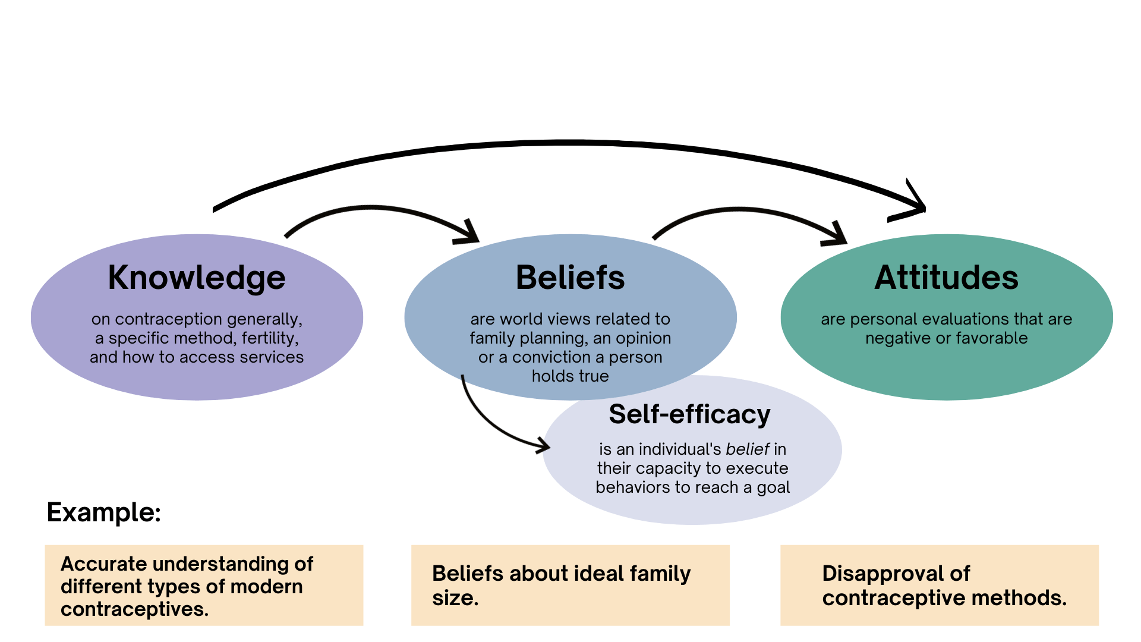
Background
Notes:
View Figure 1 in the HIP brief (copy and paste this link into your web browser): https://www.fphighimpactpractices.org/briefs/knowledge-attitudes-and-beliefs/

Slide 9
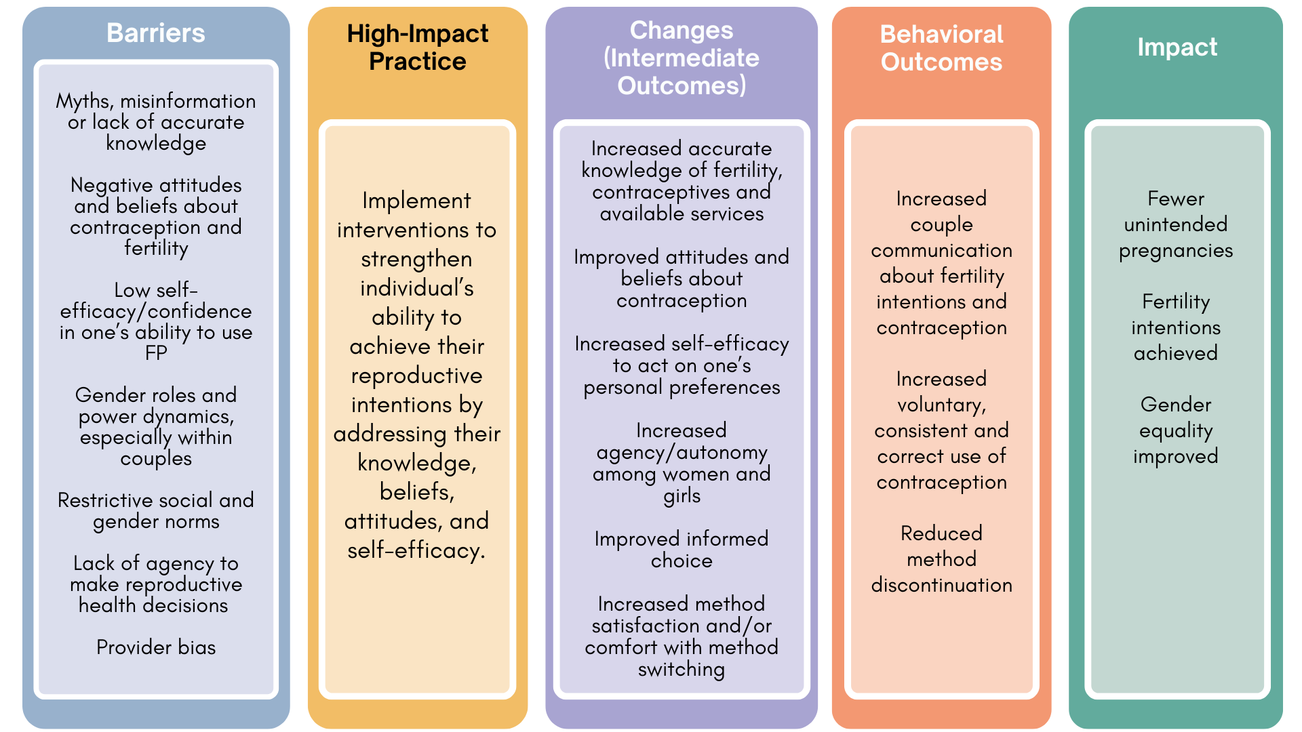
Theory of
Change
BACKGROUND
Notes:
View Figure 2 in the HIP brief (copy and paste this link into your web browser): https://www.fphighimpactpractices.org/briefs/knowledge-attitudes-and-beliefs/

Slide 10
Why is this practice important?
Strengthening family planning knowledge is fundamental to voluntary, informed, and correct contraceptive use.
Addressing knowledge, beliefs, and attitudes can help to dispel myths and misconceptions about contraception, which are significant barriers to voluntary and consistent contraceptive use.
Notes:
Strengthening family planning knowledge is fundamental to voluntary, informed, and correct contraceptive use.
Individuals who have correct information about contraception, including about its side effects, tend to look favorably upon and to be more likely to use family planning.
Among adolescents from low- and middle-income countries (LMICs), low levels of sexual and reproductive health knowledge are associated with reduced access to contraception, particularly among unmarried adolescents.
The importance of accurate family planning knowledge has been heightened with the advent of the Internet and social media, which can be used to rapidly spread misinformation.
Addressing knowledge, beliefs, and attitudes can help to dispel myths and misconceptions about contraception, which are significant barriers to voluntary and consistent contraceptive use.
Holding myths and misconceptions is a strong predictor of non-use or has been cited as a barrier to contraceptive use in several countries.

Slide 11
Why is this practice important?
Favorable attitudes about family planning influence voluntary and consistent contraceptive uptake.
Self-efficacy is associated with voluntary contraceptive use, avoiding unintended pregnancies, and intention to use contraception.
Notes:
Favorable attitudes about family planning influence voluntary and consistent contraceptive uptake.
Supportive attitudes by influential individuals (including religious leaders, husbands, and mothers-in-law) also strongly influence contraceptive uptake by women.
Self-efficacy is associated with voluntary contraceptive use, avoiding unintended pregnancies, and intention to use contraception.
A qualitative study in Mozambique found that fostering individual-level protective factors such as hope and self-efficacy among young women can help to prevent pregnancy and child marriage.

Slide 12
What interventions address knowledge, beliefs, attitudes, and self-efficacy?
SBC efforts have been documented through:
  Mass media (TV, radio, and print).
  Multi-level interventions (not including mass media).
  Individual and couples’ family planning counseling.
  Community group engagement, participatory group discussions or workshops.
  Digital tools.
Notes:
Evidence indicates SBC interventions that address factors at more than one ecological level (also known as multi-level interventions) are most effective in reaching their ultimate behavioral and health goals.
While there are numerous SBC family planning studies advancing family planning outcomes by addressing knowledge, beliefs, and attitudes, there are less family planning interventions that address self-efficacy in LMICs and that have done it successfully.
SBC efforts to address knowledge, beliefs, attitudes, and self-efficacy to strengthen an individual’s ability to achieve their reproductive intentions have been documented through:
Mass media (TV, radio, and print), particularly in the context of multi-level interventions.
A systematic review found that in eight of nine family planning mass media studies, exposure to mass media content was associated with higher levels of knowledge and/or positive attitudes about contraception.
Multi-level interventions (not including mass media).
These interventions use several communication channels and activities addressing factors at different socio-ecological levels (i.e., individual, interpersonal, community, organizational, enabling environment).
Individual and couples’ family planning counseling.
Experience shows that counseling is most successful when it addresses individual client preferences and needs.
Community group engagement, participatory group discussions or workshops.
These interventions are facilitated discussions following a pre-designed curriculum and they can be offered in the form of short one-time sessions, longer workshops, or monthly meetings.
One of the main characteristics is that they use participatory methodologies such as small group discussions, role plays, and small group work.
Digital tools.
Experts believe that the impact of interventions using digital tools to achieve family planning goals may be enhanced by pairing digital tools with multi-level intervention components, such as activities to address service and contraceptive access barriers.

Slide 13
What interventions address knowledge, beliefs, attitudes, and self-efficacy?
Jordan: multi-level intervention (not including mass media)
The program provided home-based family planning counseling to married women.
Compared to no counseling, family planning knowledge improved in the women-only counseling and couples-counseling groups.
Notes:
The Knowledge, Beliefs, Attitudes, and Self-efficacy HIP brief contains highlights from intervention studies in Nigeria, Jordan, Guinea, and Bangladesh. For more information, please copy and paste this link into your web browser: https://www.fphighimpactpractices.org/briefs/knowledge-attitudes-and-beliefs/

Slide 14

Implementation Measurement
Percent of target audience that knows potential contraceptive side effects.
Percent of target audience with favorable attitudes of modern family planning methods.
Percent of target audience with high self-efficacy/confidence in their ability to use family planning.
Percent of target audience with high self-efficacy/confidence in their ability to talk to a family planning provider.

Slide 15
Thank You
Continue to the extra slides or access the HIP brief for more information.

Slide 16
Extra Slides
Implementation Tips
Priority Research Questions
Tools & Resources
Notes:
We have put together a collection of implementation tips for Knowledge, Beliefs, Attitudes, and Self-efficacy, in case you have additional time in your meeting. Further information about these tips can be found in the HIP brief.
References from the literature on this HIP can be found here (copy and paste this link into your web browser): https://www.fphighimpactpractices.org/briefs/knowledge-attitudes-and-beliefs/

Slide 17

Implementation Tips
Use formative research to understand local knowledge, beliefs, attitudes, and self-efficacy about family planning.
Formative research ensures that interventions address specific barriers and facilitators in the local context.
Formative research can entail reviews of existing studies, or using qualitative methods (e.g., focus group discussions, individual interviews) or new methodologies such as human-centered design to collect information.

Slide 18
Implementation Tips
Design messages that are culturally appropriate and meaningful to the audience.
When designing messages, connect insights about the audience (e.g., their values about family size) gathered during formative research with key information the audience needs to know, think, or feel in order to change the behavioral outcome (e.g., use a modern family planning method).

Slide 19
Implementation Tips
Consider existing levels of individual knowledge about family planning and fertility.
When existing levels of knowledge are high, focus on increasing self-efficacy so that individuals can act on their knowledge.

Slide 20
Implementation Tips
Address myths and misconceptions directly, but carefully.
Train counselors, family planning providers, and/or community health workers on how to address myths and misconceptions, including those about common side effects and contraceptive-induced menstrual changes.
In all messaging around myths and misconceptions, use compelling language delivered by trusted sources for your specific audience.

Slide 21
Implementation Tips
Address potential “side benefits” of contraception, including other potential health and lifestyle advantages in addition to addressing barriers or challenges.
Addressing benefits as well as barriers or challenges has worked well in other areas such as promoting health service uptake.

Slide 22
Implementation Tips
Consider opportunities before, during, and after family planning services to intervene.
Improving attitudes about family planning is useful to create a supportive environment for uptake and continued use and can be achieved by, for example, working with religious leaders or messaging on mass media.

Slide 23
Implementation Tips
Improve self-efficacy for clients to communicate with family planning providers about their needs, wishes, and questions.
For example, client referral cards can include information on different family planning methods and a list of questions clients can ask, such as “How effective is this method?” and, “What side effects should I expect?”

Slide 24
Implementation Tips
When seeking to strengthen knowledge, beliefs, attitudes, and self-efficacy among men and boys, recognize their needs as family planning clients, as well as their roles as supportive partners and agents of change.
Aim for gender-synchronized interventions, which involves working with men and women, and boys and girls, in an intentional and mutually reinforcing way, to challenge restrictive gender norms and improve health.
Notes:
When seeking to strengthen knowledge, beliefs, attitudes, and self-efficacy among men and boys, recognize their needs as family planning clients, as well as their roles as supportive partners and agents of change.
It is essential to ensure that increasing men’s role in family planning does not jeopardize women’s safety and decision making.
Aim for gender-synchronized interventions, which involves working with men and women, and boys and girls, in an intentional and mutually reinforcing way, to challenge restrictive gender norms and improve health.

Slide 25
Implementation Tips
Use trusted sources of information.
Health providers are often considered a trusted source of information and clients rely on their counseling to choose a contraceptive method, so it is imperative that family planning providers have accurate knowledge and minimize personal bias.
Notes:
Use trusted sources of information.
Health providers are often considered a trusted source of information and clients rely on their counseling to choose a contraceptive method, so it is imperative that family planning providers have accurate knowledge and minimize personal bias.
Trusted sources for adolescents may be different so it is important to hear from youth how and from whom they want to learn about fertility and contraception.

Slide 26
Implementation Tips
Pay particular attention to needs of diverse adolescents.
Adolescent boys and girls require information and education tailored to their specific life stage and needs.
Because adolescents are not a monolithic group, messaging and approaches should be tailored based on life stage and other psychosocial characteristic.

Slide 27
Priority Research Questions
Do digital applications that promote family planning use by addressing knowledge, attitudes, beliefs, and self-efficacy, contribute to achieving various family planning outcomes?
How might we develop and apply standard measures for self-efficacy to SBC programming focused on contraceptive use across LMICs?
Do SBC interventions, including enhanced family planning counseling models, that address self-efficacy and agency improve various family planning outcomes?
Notes:
These research questions, reviewed by the HIP technical advisory group, reflect the prioritized gaps in the evidence base specific to the topics reviewed in this brief and focus on the HIP criteria.

Slide 28

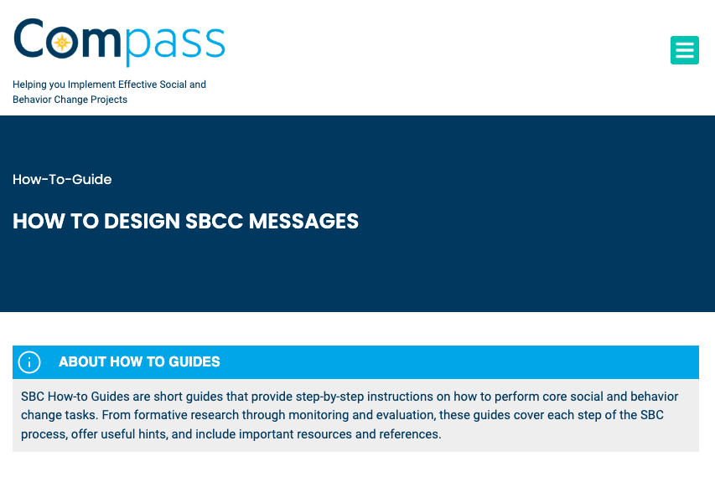
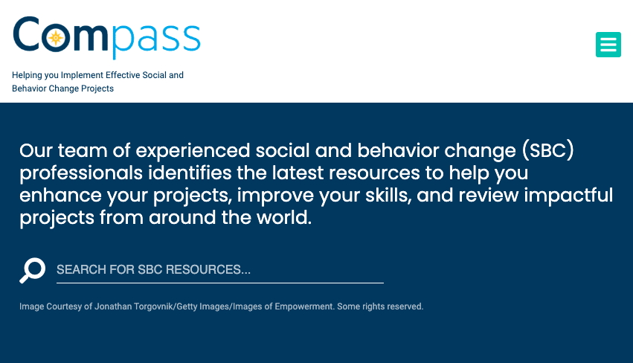
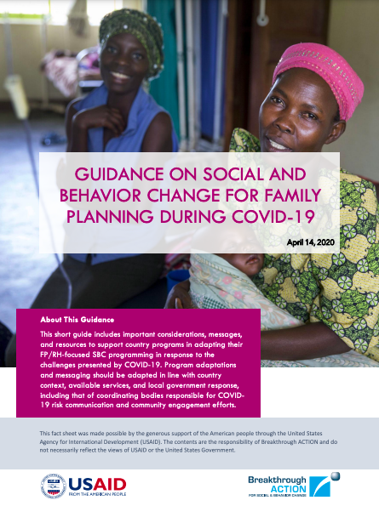
Tools & Resources
How to Design SBCC Messages
The Compass
Guidance on Social and Behavior Change for Family Planning During COVID-19
Notes:
How to Design SBCC Messages is a how-to guide that provides step-by-step instructions, useful hints, and key resources and references to support development of evidence-informed SBCC messages. Available from: https://thecompassforsbc.org/how-to-guide/how-design-sbcc-messages
The Compass is a website that includes a curated collection of SBC resources to help SBC professionals improve their work. It includes how-to-guides on how to perform fundamental SBC tasks; resources highlighting trending topics; and spotlights on how successful SBC programs were designed, implemented, and evaluated. Available from: https://thecompassforsbc.org/
Guidance on Social and Behavior Change for Family Planning During COVID-19 is a guide that includes considerations, messages, and resources to guide adaptation of SBC programming focused on family planning and reproductive health in response to COVID-19 challenges. Available from: https://covid19communicationnetwork.org/wp-content/uploads/2020/05/Guidance-on-SBC-for-FP-During-COVID-19-EN_v1.1.pdf

Slide 29
fphighimpactpractices.org
Notes:
Subscribe to the HIPs Newsletter here (copy and paste this link into your web browser): https://mailchi.mp/76703a3652c9/hips-newsletter-sign-up
Please visit the five areas of our website to learn more about the HIPs:
HIP Products (copy and paste this link into your web browser): https://www.fphighimpactpractices.org/hip-products/
Resources (copy and paste this link into your web browser): https://www.fphighimpactpractices.org/resources/
Engage (copy and paste this link into your web browser): https://www.fphighimpactpractices.org/engage-with-the-hips/
Overview (copy and paste this link into your web browser): https://www.fphighimpactpractices.org/overview/
About Us (copy and paste this link into your web browser): https://www.fphighimpactpractices.org/partnership-structure/

