Slide 1




Social Franchising
Improving quality and expanding contraceptive choice in the private sector
Notes:
A social franchise is a network of private-sector health care providers that are linked through agreements to provide socially beneficial health services under a common franchise brand.
This brief describes the potential impact of social franchising on key family planning outcomes. It also provides useful guidance on how social franchising can be used to increase access to high-quality family planning products and services.
Photo Credit: Julius Caeser Kasuja
REVISED: 5/4/21

Slide 2
Overview
What is a HIP?
HIP Categories
Partnership
Introduction to the High Impact Practices (HIPs)
PART
Background
Theory of Change
What challenges can this HIP help address?
Evidence of Impact
PART
Social Franchising
Priority Research Questions
Implementation Tips
Tools & Resources
Extra Slides
11
Social Franchising
02
Notes:
Thank you for using this slide deck! This is a product derived from the HIP brief to assist you in presenting to a variety of audiences. Instructions and additional resources are included in the notes of each slide for your convenience. There is a wealth of information and resources in the “Notes” section of each slide.
This presentation is divided in three parts: an Introduction to the High Impact Practices (HIPs) in Family Planning, Social Franchising, and Extra Slides.
The logo for your organization or ministry may be added to these slides. The web addresses provided in the “Notes” section of each slide can be copied and pasted into your web browser.

Slide 3



High Impact Practices in Family Planning (HIPs) are…
Evidence-based family planning practices
Vetted by experts against specific criteria
Documented in an easy-to-use format
Social Franchising
03
Notes:
High Impact Practices (HIPs) are a set of evidence-based family planning practices vetted by experts against specific criteria and documented in an easy-to-use format.
The High Impact Practices in Family Planning (HIPs) were first created in 2010 after a survey of FP stakeholders revealed little consensus for “what works” in international FP programming. A small group of leaders in FP were brought together with the task of identifying a short list of HIPs that if implemented at scale would help countries address the unmet need for FP and thereby increase national contraceptive prevalence.
HIPs are identified based on demonstrated magnitude of impact on contraceptive use and potential application in a wide range of settings. Consideration is also given to other relevant outcome measures including unintended pregnancy, fertility, or one of the primary proximate determinants of fertility (delay of marriage, birth spacing, or breast feeding). Evidence of replicability, scalability, sustainability, and cost-effectiveness are also considered.
For more information, please copy and paste this link into your web browser to see this video: https://www.youtube.com/watch?v=N6V0gfl-V3k&ab_channel=KnowledgeSUCCESS
A 2-pager overview of the HIPs is available in an online and a downloadable PDF format here (copy and paste this link into your web browser): https://www.fphighimpactpractices.org/high-impact-practices-in-family-planning-list/

Slide 4
HIPs address the full spectrum of FP programming
Enabling Environment
Service Delivery
Social and Behavioral Change
PART
Address systemic barriers that affect an individual’s ability to access family planning information & services. 6 briefs
Improve the availability, accessibility, acceptability, and quality of family planning services. 8 briefs
Influence knowledge, beliefs, behaviors, and social norms associated with family planning.
3 briefs
Enhancements
Approaches used in conjunction with HIPs to maximize the impact of HIP implementation or increase the reach. 4 briefs
Social Franchising
04
Notes:
There are three categories of HIPs: Enabling Environment, Service Delivery and Social and Behavioral Change. Social Franchising is a service delivery HIP. This information came from the HIP List (copy and paste this link into your web browser): https://www.fphighimpactpractices.org/high-impact-practices-in-family-planning-list/
A HIP Enhancement is a tool or approach that is not a standalone practice, but it is often used in conjunction with HIPs to maximize the impact of HIP implementation or increase the reach and access for specific audiences. The intended purpose and impact of enhancements are focused and, therefore the evidence-based and impact of an enhancement is subjected to different standards than a HIP.
For more information about the HIP Categories and Enhancements, please copy and paste this link into your web browser: https://www.fphighimpactpractices.org/high-impact-practices-in-family-planning-list/
Here are a few examples of HIPs from each category:
Service Delivery:
Immediate Postpartum Family Planning
Mobile Outreach Services
Postabortion Family Planning
Enabling Environment:
Domestic Public Financing
Educating Girls
Supply Chain Management
Social and Behavior Change:
Community Group Engagement
Digital Health for SBC
Mass Media
Enhancements:
Digital Health for Systems
Adolescent-Friendly Contraceptive Services
Family Planning Vouchers
All HIPs are Available in English, Spanish, French, and Portuguese.

Slide 5





HIP Partnership
The Technical Advisory Group (TAG) is made up of 25 experts in family planning, including representatives from the co-sponsors.
The Co-sponsors include the following organizations:
Social Franchising
05
Notes:
The High Impact Practices in Family Planning (HIPs) are supported by over 65 organizations. These organizations play a vital role in developing, reviewing, disseminating, and implementing HIPs in family planning.
The HIPs partnership includes various structures to ensure HIP products are developed, kept up to date, and disseminated widely. These include:
Co-sponsors – Serve as the secretariat for the HIPs.
Partners – Contribute to key HIP products and endorse the HIPs.
Technical Advisory Group – Ensure high technical quality of key HIP products and approve HIP brief and SPG concepts for development.
P&D Team – Support the production and dissemination (P&D) of HIP products.
Technical Expert Groups – Write new HIP briefs and ensure they are up-to-date.
For more information about the HIP Partnership, please copy and paste this link into your web browser: https://www.fphighimpactpractices.org/partnership-structure/

Slide 6
High Impact Practice
Organize private providers into branded, quality-assured networks to increase access to provider-dependent contraceptive methods and related services.
Social Franchising
06
Notes:
A social franchise is a network of private-sector health care providers that are linked through agreements to provide socially beneficial health services under a common franchise brand.
This brief describes the potential impact of social franchising on key family planning outcomes. It also provides useful guidance on how social franchising can be used to increase access to high-quality family planning products and services.
For more information about Service Delivery HIPs, please copy and paste this link into your web browser to visit this matrix of tools developed by IBP/WHO: https://www.fphighimpactpractices.org/ibp-who-matrix/
These tools can be used in conjunction with Service Delivery HIPs.
Available in online and downloadable PDF format.
Did you know that we have a webinar recording and downloadable PDF presentation about this HIP? Please copy and paste this link into your web browser to visit: https://www.fphighimpactpractices.org/social-franchising-improving-quality-and-expanding-contraceptive-choice-in-the-private-sector-webinar/
This webinar contains recent implementation successes in several country contexts.
Presenters:
Sarah Thurston, Population Services International (PSI)
Tesfaye Mesele, MSI (formerly Marie Stopes International) – Ethiopia
Daniel Crapper, PSI/Myanmar
Martyn Smith, FP2020 (Moderator)

Slide 7
Background
A social franchise is a network of private-sector health care providers that are linked through agreements to provide socially beneficial health services under a common franchise brand.
This type of network can be particularly important for expanding availability and improving the quality of family planning services in the private sector.
Social Franchising
07
Notes:
For more information, please copy and paste this link into your web browser to reference the “Background” section on the HIP brief: https://www.fphighimpactpractices.org/briefs/social-franchising/

Slide 8
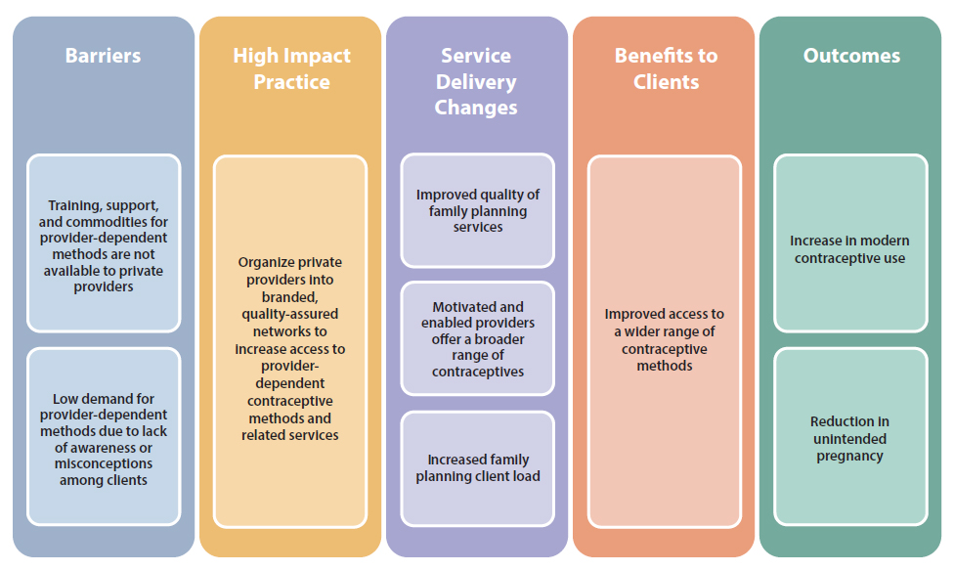
Theory of
Change
BACKGROUND
Social Franchising
08
Notes:
Even though private providers are a common source of family planning services, many do not offer a full range of methods. Independent private providers may lack training and support to offer provider-dependent methods; they may find commodities for these methods prohibitively expensive and accessing free or subsidized stocks difficult and time consuming; and some note low demand for these methods among their clientele (see Figure 1).
Nonetheless, failure to offer these methods within the range of services available represents a missed opportunity to leverage existing health care infrastructure and client health-seeking behaviors to expand access to a broad range of family planning methods.
View Figure 1 in the HIP brief (copy and paste this link into your web browser): https://www.fphighimpactpractices.org/briefs/social-franchising/

Slide 9
What challenges can this HIP help countries address?
Social franchising can improve the quality of clinical family planning services delivered by private sector providers.
Social franchising can bring more family planning clientele to participating private-sector clinics.
Social franchising supports access to and voluntary use of long-acting and permanent methods.
Social franchising can support coordination of independent private providers with public health systems in support of goals like Universal Health Coverage.
Social Franchising
09
Notes:
Social franchising can improve the quality of clinical family planning services delivered by private sector providers.
A systematic review found that franchised clinics typically score higher on quality ratings than non-franchised private clinics, although an additional review reported mixed results.
With support from the franchisor, franchisee clinics have demonstrated that they can improve clinical quality standards, including high-quality counseling, provider competence, infection prevention, and clinical governance.
Beyeler et al. concluded that “franchising may be a particularly useful strategy in areas where a large unregulated private sector provides the majority of health services.”
Social franchising can bring more family planning clientele to participating private-sector clinics.
Several studies show that clinics experience a rise in family planning visits after joining a franchise.
Studies in Myanmar and Vietnam documented an increase of approximately 40% in client loads of franchisee clinics compared with volumes prior to joining the franchise network.
Social franchising supports access to and voluntary use of long-acting and permanent methods.
Studies in Kenya and Pakistan show that women living in catchment areas served by a social franchise facility are more likely to be using a long-acting reversible contraceptive (LARC) or permanent method than women in areas without a social franchise.
Routine service data from one large global franchisor showed that in 2014 nearly 70% of methods provided by social franchisee clinics were implants and IUDs, and nearly 50% of clients who adopted a method at their visit and who had not been using a modern method for at least three months prior to their visit had chosen an implant or IUD.
Social franchising can support coordination of independent private providers with public health systems in support of goals like Universal Health Coverage.
A key component to most family planning social franchise networks is access to family planning commodities through government stocks.
Accessing free or subsidized commodities enables franchisees to make a reasonable profit margin from family planning services while keeping service prices affordable for the client.
Experts believe that social franchise networks can act as an “aggregator” of the private sector to, for example, link franchisees to national health insurance programs

Slide 10

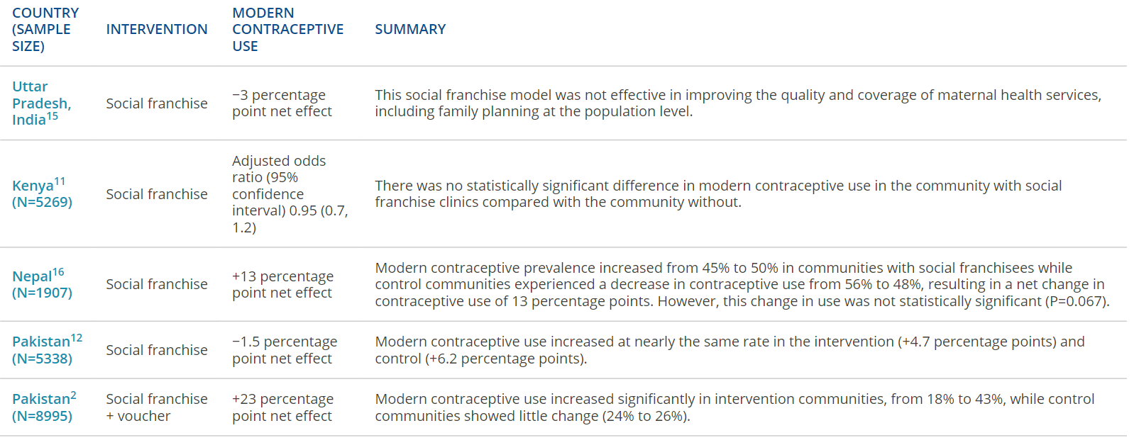
Evidence of Impact
Evidence Summary of the Effect of Social Franchising on Modern Contraceptive Use
05
Social Franchising
10
Notes:
Social franchise networks deliver family planning services in a wide variety of contexts.
Large social franchise networks are being implemented in middle-income countries such as India and South Africa as well as in fragile, less-developed markets such as the Democratic Republic of the Congo and Mali.
The network size varies, with some programs reaching significant scale.
In Kenya, for example, internal program data indicate that more than 750 social franchise facilities operate countrywide (internal MSI and PSI program data).
Bangladesh includes more than 6,300 franchised facilities that serve over 1.3 million clients.
Evidence is unclear as to whether social franchising contributes to population-level increases in contraceptive use.
Experimental studies in India, Nepal, and Pakistan found no statistically significant difference in contraceptive prevalence in communities before and after franchisee facilities were introduced.
In Kenya, multivariate analysis found that women in communities with social franchisees were no more likely to be modern contraceptive users than women living in communities without social franchisees. Table 1 provides additional details of these studies.
The cost-effectiveness of family planning social franchise networks remains undetermined.
Studies in Ethiopia, Myanmar, and Pakistan have examined the cost-effectiveness of social franchising. However, differences in study approaches, methodologies and measures make it difficult to draw generalizable conclusions from these works.
Efforts are underway to standardize methods and approaches for more conclusive results.
View Table 1 in the HIP brief (copy and paste this link into your web browser): https://www.fphighimpactpractices.org/briefs/social-franchising/

Slide 11
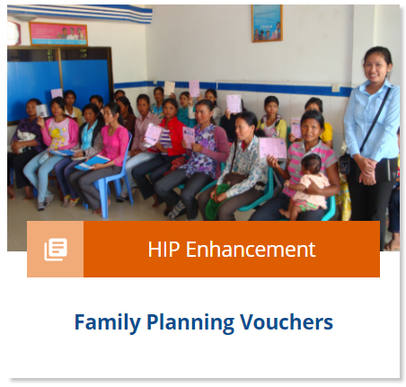

Evidence of Impact
There may be greater impact when combining social franchising with a voucher program.
Social franchising helps private providers incorporate adolescent-responsive contraceptive services.
05
Social Franchising
11
Notes:
There may be greater impact when combining social franchising with a voucher program.
A study in Pakistan documented a net increase of 23 percentage points in modern contraceptive use in districts served by social franchise facilities participating in a voucher program.
For more information, please copy and paste this link into your web browser to visit the related HIP brief: https://www.fphighimpactpractices.org/briefs/family-planning-vouchers/
Social franchising helps private providers incorporate adolescent-responsive contraceptive services.
Studies in Kenya and Madagascar demonstrate that training franchisees on youth-friendly principles and including young people in the marketing strategy can increase modern contraceptive use, including the voluntary use of LARCs among youth – both male and female.
For more information, please copy and paste this link into your web browser to visit the related HIP brief: https://www.fphighimpactpractices.org/briefs/adolescent-responsive-contraceptive-services/

Slide 12
Social franchising is a promising practice
A promising practice has limited evidence, with more information needed to fully document implementation experience and impact. The advisory group recommends that such promising interventions be promoted widely, provided they are implemented within the context of research and are carefully evaluated in terms of both impact and process.
05
Social Franchising
12

Slide 13
Thank You
Continue to the extra slides or access the HIP brief for more information.
Social Franchising
13
Notes:
For more information, please copy and paste this link into your web browser to visit this webpage with a recording of the webinar on Social Franchising and a downloadable PDF version of the presentation: https://www.fphighimpactpractices.org/social-franchising-improving-quality-and-expanding-contraceptive-choice-in-the-private-sector-webinar/

Slide 14
Extra Slides
Priority Research Questions
Implementation Tips
Tools & Resources
Social Franchising
14
Notes:
We have put together a collection of implementation tips for social franchising, in case you have additional time in your meeting. Further information about these tips can be found in the HIP brief.
References from the literature on this HIP can be found here (copy and paste this link into your web browser): https://www.fphighimpactpractices.org/wp-content/uploads/2018/04/Social-Franchsing-References.pdf

Slide 15
Priority Research Questions
What is the effect of social franchising on contraceptive prevalence in communities served by social franchise clinics?
What is the differential impact on contraceptive use of social franchising with and without a voucher component?
What are the associated costs with maintaining a social franchise?
05
Social Franchising
15
Notes:
These research questions, reviewed by the HIP technical advisory group, reflect the prioritized gaps in the evidence base specific to the topics reviewed in this brief and focus on the HIP criteria.

Slide 16

Implementation Tips
Box 1. Health Market Conditions That Likely Lead to Social Franchising Success
The private medical sector, especially the outpatient sector, has adequate infrastructure and human resource capacity
Poor and underserved client groups currently seek care from private providers
The public sector is overburdened and/ or unable to adequately address unmet need for family planning
The government is interested in and supportive of developing, regulating, or contracting the private sector
Clients or third-party payers are willing to buy health services offered in small or mid-size private-sector outlets
Clients or third-party payers are able to pay for services, either through out-of-pocket payments, health insurance, or other demand-side financing schemes
Adequate resources are available for franchise set-up and ongoing management
The policy environment is favorable to task sharing whereby mid-level providers can offer the franchised package of services
Assess health market conditions.
Social Franchising
16
Notes:
Assess health market conditions.
Social franchising is more likely to deliver intended results in markets where certain conditions exist, such as where the private sector is already delivering a substantial portion of health services and when the government is supportive of private-sector partnerships (see Box 1).

Slide 17
Implementation Tips
Seek opportunities to engage large social franchise networks and geographic coverage.
Recruit franchisees selectively.
Identify franchisees that have underutilized capacity to maximize health impact.
Clarify expectations and commitments between franchisor and franchisee at the outset.
Take into account client service volumes of each franchise.
Social Franchising
17
Notes:
Seek opportunities to engage large social franchise networks and geographic coverage.
Larger networks benefit more from economies of scale with certain activities, for example, in procurement of health commodities and supplies, demand-side interventions, and marketing support.
A degree of regional focus allows supportive supervision to be conducted in a more cost-effective manner and supports cross-network learnings and referrals (i.e., interaction between franchisees).
Recruit franchisees selectively.
Successful franchisees must see value in franchise network membership, be motivated to expand their contraceptive service offerings, and be open and responsive to supportive supervision.
With attention to equity, prospective franchisees should be located in lower-income catchment areas.
Identify franchisees that have underutilized capacity to maximize health impact.
Prospective franchisees should have the ability to increase the range and quality of services they offer and the capacity to serve more clients.
De-franchising—that is, removing a facility from the franchise network—is sometimes necessary when franchisees are unable or unwilling to improve their quality to meet clinical standards or other franchise requirements.
However, high rates of de-franchising point to poor initial franchisee selection and/or failure of the franchisor to deliver inputs that are valuable to the franchisee.
Clarify expectations and commitments between franchisor and franchisee at the outset.
A written agreement between franchisor and franchisee sets out defined quality standards, expected services available, and roles and responsibilities between parties.
Agreements may also include the price guidance at which these services should be offered.
Take into account client service volumes of each franchise.
Franchisee providers must serve enough clients and deliver enough services to maintain their technical skills and benefit from network-related increases in revenue.
Since ongoing supportive supervision of franchisees is resource-intensive, client and service volume are key for the intervention to be cost-effective.
Many franchisors offer support to franchisees with clinic branding, marketing of franchised services, and family planning awareness raising at the community level.
These interventions can help promote the availability of new services and grow and maintain family planning client volumes.

Slide 18
Implementation Tips
Consider offering a broad range of services as part of the franchise package.
Meet the needs and preferences of female and male clients under age 25 by including youth-friendly contraceptive services.
Consider demand-side subsidies, such as vouchers or participation in health insurance, to effectively serve youth and clients from the lowest income quintiles.
Social Franchising
18
Notes:
Consider offering a broad range of services as part of the franchise package.
IUD and implant services are the most commonly added family planning services when a clinic joins a family planning social franchise network.
Currently, social franchising is not a major channel for expanding access to voluntary permanent methods because franchisee clinics tend to be staffed by mid-level providers who, in most contexts, are not permitted to deliver tubal ligation and vasectomy.
Social franchising may present increased opportunities for permanent methods, especially in countries with task-shifting policy changes underway.
Franchisees may be better positioned for inclusion in national health insurance programs when a broader package of services is offered.
Meet the needs and preferences of female and male clients under age 25 by including youth-friendly contraceptive services.
Young clients may already prefer accessing family planning from the private sector, where many may perceive greater anonymity and privacy.
Franchisors can proactively support franchisee providers to better reach and serve young clients through organized media campaigns, use of social media, flexible clinic hours, and provider training on how to deliver confidential, nonjudgmental services.
For more information, please copy and paste this link into your web browser to visit the related HIP brief: https://www.fphighimpactpractices.org/guides/improving-sexual-and-reproductive-health-of-young-people/
Consider demand-side subsidies, such as vouchers or participation in health insurance, to effectively serve youth and clients from the lowest income quintiles.
Most frequently, clients of social franchisees pay a family planning service fee, although these prices are typically subject to price guidance by the franchisor to maintain affordability.
To reach the lowest-wealth quintile clients and young people with limited purchasing power, voucher programs, sliding-scale fees, and, increasingly, participation in health insurance schemes have been successfully used alongside social franchising in a number of countries.
For more information, please copy and paste this link into your web browser to visit the related HIP brief: https://www.fphighimpactpractices.org/briefs/family-planning-vouchers/

Slide 19




Tools & Resources
Social Franchising for Health e-Learning Course
Total Market Approach to Family Planning Services e-Learning Course
Clinical Social Franchising Compendium
05
Social Franchising
19
Notes:
Social Franchising for Health e-learning course uses interactive content and real-life country examples to teach participants about social franchising models. Available from https://www.globalhealthlearning. org/course/social-franchising
Total Market Approach to Family Planning Services e-learning course aims to teach participants about effectively targeting subsidies in health systems where health care is delivered through both the public and private sector. Available from https://www.globalhealthlearning.org/course/total-market-approach-family-planning-services
Clinical Social Franchising Compendium. An Annual Survey of Programs: Findings From 2015 features findings from an annual survey of social franchise programs worldwide, including the geographies and populations they serve, the health care services they franchise, how they work, and how well they work. Available from https://globalhealthsciences.ucsf.edu/sites/globalhealthsciences.ucsf.edu/files/pub/sf4h-social-franchising-compendium-2016.pdf
Bonus resource: Use of the WHO Guidelines & Tools alongside service delivery High Impact Practices in family planning. The tool focuses on Service Delivery HIPs and selected WHO Guidelines related to family planning service delivery. The tool is intended to be a quick reference for program managers designing or implementing family planning programs. The tool can be used to help improve implementation of HIPs by illustrating how to incorporate WHO evidence-based guidelines and/or can be used to support advocacy efforts for HIPs by linking them with globally recognized and credible WHO Guidelines. Please copy and paste this link into your web browser to visit: https://www.fphighimpactpractices.org/ibp-who-matrix/

Slide 20

fphighimpactpractices.org
Notes:
Subscribe to the HIPs Newsletter here (copy and paste this link into your web browser): https://mailchi.mp/76703a3652c9/hips-newsletter-sign-up
Please visit the five areas of our website to learn more about the HIPs:
HIP Products (copy and paste this link into your web browser): https://www.fphighimpactpractices.org/hip-products/
Resources (copy and paste this link into your web browser): https://www.fphighimpactpractices.org/resources/
Engage (copy and paste this link into your web browser): https://www.fphighimpactpractices.org/engage-with-the-hips/
Overview (copy and paste this link into your web browser): https://www.fphighimpactpractices.org/overview/
About Us (copy and paste this link into your web browser): https://www.fphighimpactpractices.org/partnership-structure/

