Slide 1
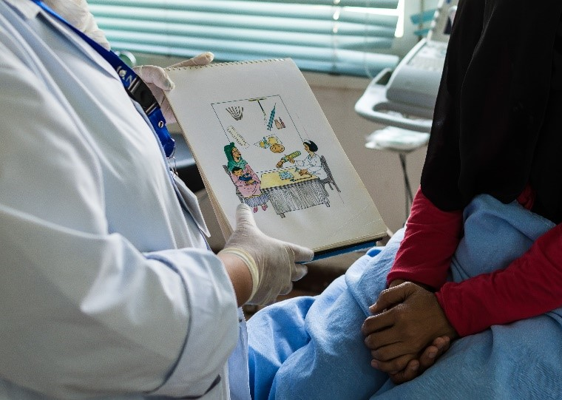



Postabortion
Family Planning
A critical component of postabortion care
Notes:
Postabortion family planning is one of several high impact practices in family planning (HIPs) identified by a technical advisory group of international experts.
When scaled up and institutionalized, HIPs will maximize investments in a comprehensive family planning strategy.
Photo credit: UNFPA
REVISED: 5/4/21

Slide 2
Overview
What is a HIP?
HIP Categories
Partnership
Introduction to the High Impact Practices (HIPs)
PART
Background
Theory of Change
What challenges can Postabortion FP help address?
Recommended Indicators
Evidence of Impact
PART
Postabortion Family Planning
Implementation Tips
Tools & Resources
Extra Slides
11
Postabortion Family Planning
02
Notes:
Thank you for using this slide deck! This is a product derived from the HIP brief to assist you in presenting to a variety of audiences. Instructions and additional resources are included in the notes of each slide for your convenience. There is a wealth of information and resources in the “Notes” section of each slide.
This presentation is divided in three parts: an Introduction to the High Impact Practices (HIPs) in Family Planning, Postabortion Family Planning, and Extra Slides.
The logo for your organization or ministry may be added to these slides. The web addresses provided in the “Notes” section of each slide can be copied and pasted into your web browser.

Slide 3



High Impact Practices in Family Planning (HIPs) are…
Evidence-based family planning practices
Vetted by experts against specific criteria
Documented in an easy-to-use format
Postabortion Family Planning
03
Notes:
High Impact Practices (HIPs) are a set of evidence-based family planning practices vetted by experts against specific criteria and documented in an easy-to-use format.
The High Impact Practices in Family Planning (HIPs) were first created in 2010 after a survey of FP stakeholders revealed little consensus for “what works” in international FP programming. A small group of leaders in FP were brought together with the task of identifying a short list of HIPs that if implemented at scale would help countries address the unmet need for FP and thereby increase national contraceptive prevalence.
HIPs are identified based on demonstrated magnitude of impact on contraceptive use and potential application in a wide range of settings. Consideration is also given to other relevant outcome measures including unintended pregnancy, fertility, or one of the primary proximate determinants of fertility (delay of marriage, birth spacing, or breast feeding). Evidence of replicability, scalability, sustainability, and cost-effectiveness are also considered.
For more information, please copy and paste this link into your web browser to see this video: https://www.youtube.com/watch?v=N6V0gfl-V3k&ab_channel=KnowledgeSUCCESS
A 2-pager overview of the HIPs is available in an online and a downloadable PDF format here (copy and paste this link into your web browser): https://www.fphighimpactpractices.org/high-impact-practices-in-family-planning-list/

Slide 4
HIPs address the full spectrum of FP programming
Enabling Environment
Service Delivery
Social and Behavioral Change
PART
Address systemic barriers that affect an individual’s ability to access family planning information & services. 6 briefs
Improve the availability, accessibility, acceptability, and quality of family planning services. 8 briefs
Influence knowledge, beliefs, behaviors, and social norms associated with family planning.
3 briefs
Enhancements
Approaches used in conjunction with HIPs to maximize the impact of HIP implementation or increase the reach. 4 briefs
Postabortion Family Planning
04
Notes:
There are three categories of HIPs: Enabling Environment, Service Delivery and Social and Behavioral Change. Postabortion Family Planning is a service delivery HIP. This information came from the HIP List (copy and paste this link into your web browser): https://www.fphighimpactpractices.org/high-impact-practices-in-family-planning-list/
A HIP Enhancement is a tool or approach that is not a standalone practice, but it is often used in conjunction with HIPs to maximize the impact of HIP implementation or increase the reach and access for specific audiences. The intended purpose and impact of enhancements are focused and, therefore the evidence-based and impact of an enhancement is subjected to different standards than a HIP.
For more information about the HIP Categories and Enhancements, please copy and paste this link into your web browser: https://www.fphighimpactpractices.org/high-impact-practices-in-family-planning-list/
Here are a few examples of HIPs from each category:
Service Delivery:
Immediate Postpartum Family Planning
Mobile Outreach Services
Postabortion Family Planning
Enabling Environment:
Domestic Public Financing
Educating Girls
Supply Chain Management
Social and Behavior Change:
Community Group Engagement
Digital Health for SBC
Mass Media
Enhancements:
Digital Health for Systems
Adolescent-Friendly Contraceptive Services
Family Planning Vouchers
All HIPs are Available in English, Spanish, French, and Portuguese.

Slide 5





HIP Partnership
The Technical Advisory Group (TAG) is made up of 25 experts in family planning, including representatives from the co-sponsors.
The Co-sponsors include the following organizations:
Postabortion Family Planning
05
Notes:
The High Impact Practices in Family Planning (HIPs) are supported by over 65 organizations. These organizations play a vital role in developing, reviewing, disseminating, and implementing HIPs in family planning.
The HIPs partnership includes various structures to ensure HIP products are developed, kept up to date, and disseminated widely. These include:
Co-sponsors – Serve as the secretariat for the HIPs.
Partners – Contribute to key HIP products and endorse the HIPs.
Technical Advisory Group – Ensure high technical quality of key HIP products and approve HIP brief and SPG concepts for development.
P&D Team – Support the production and dissemination (P&D) of HIP products.
Technical Expert Groups – Write new HIP briefs and ensure they are up-to-date.
For more information about the HIP Partnership, please copy and paste this link into your web browser: https://www.fphighimpactpractices.org/partnership-structure/

Slide 6
High Impact Practice
Proactively offer voluntary contraceptive counseling and services at the same time and location where women receive facility-based postabortion care.
Postabortion Family Planning
06
Notes:
Postabortion family planning is one of several high impact practices in family planning (HIPs) identified by a technical advisory group of international experts.
When scaled up and institutionalized, HIPs will maximize investments in a comprehensive family planning strategy.
For more information about Service Delivery HIPs, please copy and paste this link into your web browser to visit this matrix of tools developed by IBP/WHO: https://www.fphighimpactpractices.org/ibp-who-matrix/
These tools can be used in conjunction with Service Delivery HIPs.
Available in online and downloadable PDF format.
Did you know that we have a webinar recording and downloadable PDF presentation about this HIP? Please copy and paste this link into your web browser to visit: https://www.fphighimpactpractices.org/postabortion-family-planning-a-glimpse-of-global-evidence-and-its-impact-with-country-implementation/
This webinar contains recent implementation successes in several country contexts.
Presenters:
Carolyn Curtis, Presenter, USAID
Erin Mielke, Presenter, USAID
Juliana Bantambya, Presenter, EngenderHealth
Elizabeth Tully, Facilitator, Johns Hopkins Center for Communication Programs

Slide 7
Background
Postabortion care (PAC), which includes treatment for complications from miscarriage or induced abortion, is an opportune time to counsel and offer clients voluntary contraception.
All PAC models include two essential services:
(1) treatment of emergency complications, and
(2) voluntary family planning counseling, including provision of contraception.
Postabortion Family Planning
07
Notes:
For more information, please copy and paste this link into your web browser to reference the “Background” section on the HIP brief: https://www.fphighimpactpractices.org/briefs/postabortion-family-planning/
Even if a woman wants to become pregnant again soon, she should probably wait six months to reduce the chances of low birth weight, premature birth, and maternal anemia.
Despite this evidence and decades of investments to improve PAC programs, health care systems continue to fall short.
Even when services are in place, method choice may be limited.
Significant gaps in information provided to clients, such as how to use the method correctly and follow-up information

Slide 8
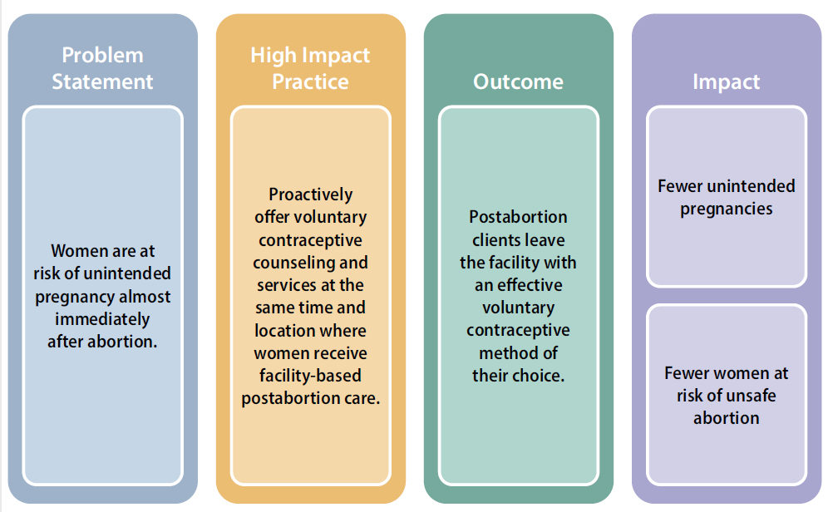
Theory of
Change
BACKGROUND
Postabortion Family Planning
08
Notes:
When clients are counseled and offered contraception as part of postabortion care most women will opt to leave the facility with an effective family planning method.
Please copy and paste this link into your web browser to view Figure 1 in the HIP brief: https://www.fphighimpactpractices.org/briefs/postabortion-family-planning/

Slide 9
What challenges can PAFP help countries address?
Postabortion family planning can reach many women and girls in need of contraceptive counseling and services.
Postabortion family planning can help clients achieve their reproductive intentions and is likely to provide cost savings for women, families and the health system.
Postabortion Family Planning
09
Notes:
Postabortion family planning can reach many women and girls in need of contraceptive counseling and services.
Induced and spontaneous abortions (miscarriages) are common. Together, they account for an estimated one-quarter of all pregnancies worldwide.
Globally, the number of induced abortions is on the rise. Nearly half of these are considered unsafe, with the overwhelming number being in developing countries.
Postabortion family planning can help clients achieve their reproductive intentions and is likely to provide cost savings for women, families and the health system.
Individuals and health systems alike bear significant costs for treating complications from unsafe abortions.
Treatment for abortion-related complications can consume nearly half of obstetrics and gynecology budgets. Costs could be reduced by investing in improving access to high-quality family planning services and increasing fertility awareness.
On average, nearly 20% of postabortion clients reported having had a previous induced abortion.
More than half of postabortion clients expressed an interest in using contraception, yet only about one-quarter (27%) left the facility with a contraceptive method.
Providing voluntary contraception to women who wish to delay or limit childbearing would cost just a fraction of the average expenditure on PAC: one year of modern contraceptive services and supplies costs, on average 3%-12% of the cost of treating a PAC patient.

Slide 10
What challenges can PAFP help countries address?
Many postabortion clients and health workers do not know that postabortion clients are at risk of pregnancy almost immediately after abortion.
Unsafe abortion is a major contributor to maternal morbidity and mortality in developing countries, and postabortion family planning can reduce subsequent abortions.
Postabortion Family Planning
10
Notes:
Many postabortion clients and health workers do not know that postabortion clients are at risk of pregnancy almost immediately after abortion.
Fertility can return within two weeks after a first-trimester abortion or miscarriage, within 4 weeks after a second-trimester abortion or miscarriage, and, on average, within three weeks following medical abortion with mifepristone or misoprostol.
Nearly two-thirds of women who received PAC did not know when fertility returns after abortion.
Women who leave a facility without a clear understanding of their pregnancy risk are almost three times more likely to have another abortion than women with accurate knowledge.
Unsafe abortion is a major contributor to maternal morbidity and mortality in developing countries, and postabortion family planning can reduce subsequent abortions.
Between 4.7% and 13.2% of maternal deaths each year can be attributed to unsafe abortion.
Unsafe abortion is the fifth leading direct cause of pregnancy-related maternal mortality.
Preventing unintended pregnancy, including among PAC clients, is fundamental to reducing the consequences of unsafe abortion.

Slide 11

Recommended Indicators
Percentage of postabortion clients who were counseled on family planning
Disaggregated by age group, <20 years vs. >20 years
Percentage of postabortion clients who leave the facility with a modern contraceptive
Disaggregated by type of method and age group, <20 years vs. >20 years
05
Postabortion Family Planning
11
Notes:
It is recommended that programs implementing postabortion family planning include these following indicators.

Slide 12

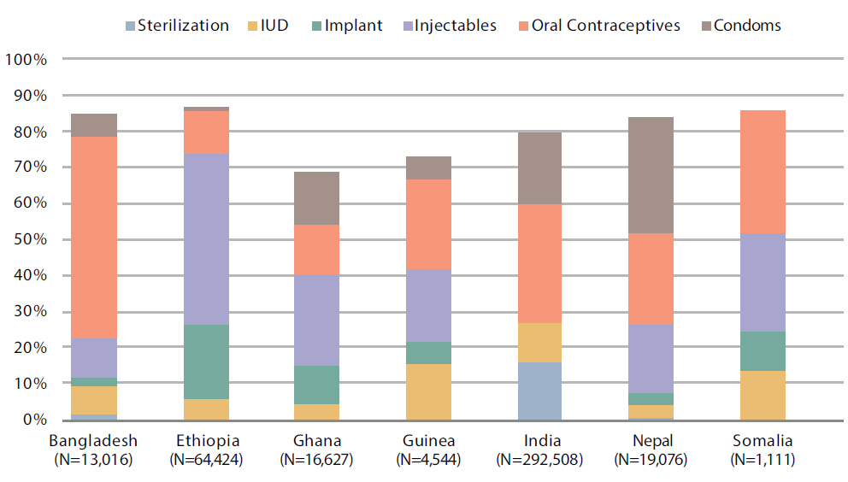
Evidence of Impact
Percentage of Postabortion Clients Leaving the Facility With a Modern Contraceptive Method in Selected Countries with High-Quality Postabortion Family Planning Services
Across a wide variety of settings, data consistently show that acceptance of contraception is high when women are offered counseling and services as part of PAC.
05
Postabortion Family Planning
12
Notes:
Across a wide variety of settings, data consistently show that acceptance of contraception is high when women are offered counseling and services as part of PAC.
Postabortion family planning uptake generally increases rapidly – and unintended pregnancies and repeat abortions can decline as a result- when a range of free contraceptives, including long-acting methods, are offered at the point of treatment.
Figure 2 provides illustrative examples of voluntary contraceptive uptake achieved in large-scale routine service delivery programs when high-quality family planning services were in place. The programs included in Figure 2 represent large-scale implementation in a diverse range of settings.
Source of data: Bangladesh, Ethiopia, Ghana, and Nepal from public-sector facilities (NGO-supported) data collected from 2011-2013. India from public-sector facilities (NGO-supported) data collected from 2011-2014. Somalia from NGO-run facilities in the Puntland data collected from 2013–2015. Guinea from public-sector facilities (NGO-supported) data collected from 2013.
Please copy and paste this link into your web browser to view Figure 2 in the HIP brief: https://www.fphighimpactpractices.org/briefs/postabortion-family-planning/

Slide 13
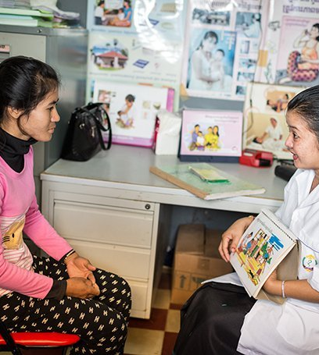
Evidence of Impact
Postabortion family planning reduces unplanned pregnancy and subsequent abortions.
05
Postabortion Family Planning
13
Notes:
Postabortion family planning reduces unplanned pregnancy and subsequent abortions.
Providing voluntary family planning services as part of PAC can increase contraceptive use and reduce subsequent abortions.
In Zimbabwe, postabortion clients who were referred to a nearby maternal and child health facility and charged a nominal fee for contraception were more than three times as likely to experience an unplanned pregnancy in the 12 months following an abortion as postabortion clients who were offered on-site, ward-based family planning services and methods for free. Similarly, in Georgia multiple abortions were significantly more common among women who did not receive postabortion contraception at the site of PAC compared with those who did.
Photo Credit © Nicolas Axelrod/Ruom for UNFPA

Slide 14

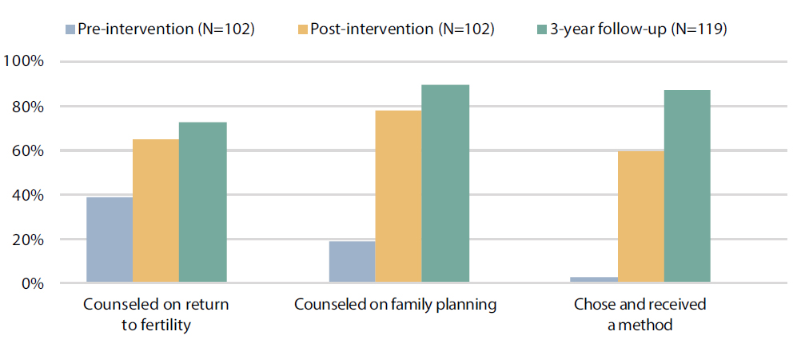
Evidence of Impact
Postabortion Family Planning Outcomes in Peru Before, During, and Three Years After Technical Assistance
Postabortion family planning is scalable and sustainable, and program effectiveness can increase over time.
Source: Benson and Huapaya (2002)
05
Postabortion Family Planning
14
Notes:
Postabortion family planning is scalable and sustainable, and program effectiveness can increase over time.
Figure 3 shows data from Peru, where institutions have strengthened the family planning component of PAC and sustained or improved on these gains well after technical assistance ended. Specifically, three years after technical assistance ended, over 80% of postabortion clients received a method prior to leaving the facility compared with just under 60% during the technical assistance period. Similar findings have been shown in Turkey.
Please copy and paste this link into your web browser to view Figure 3 in the HIP brief: https://www.fphighimpactpractices.org/briefs/postabortion-family-planning/

Slide 15
Thank You
Continue to the extra slides or access the HIP brief for more information.
Postabortion Family Planning
15
Notes:
For more information, please copy and paste this link into your web browser to visit this webpage with a recording of the webinar on Postabortion FP and a downloadable PDF version of the presentation: https://www.fphighimpactpractices.org/postabortion-family-planning-a-glimpse-of-global-evidence-and-its-impact-with-country-implementation/

Slide 16
Extra Slides
Implementation Tips
Tools & Resources
Postabortion Family Planning
16
Notes:
We have put together a collection of implementation tips for postabortion FP, in case you have additional time in your meeting. Further information about these tips can be found in the HIP brief.
References from the literature on this HIP can be found here (copy and paste this link into your web browser): https://www.fphighimpactpractices.org/wp-content/uploads/2019/04/Postabortion-Family-Planning-References.pdf

Slide 17


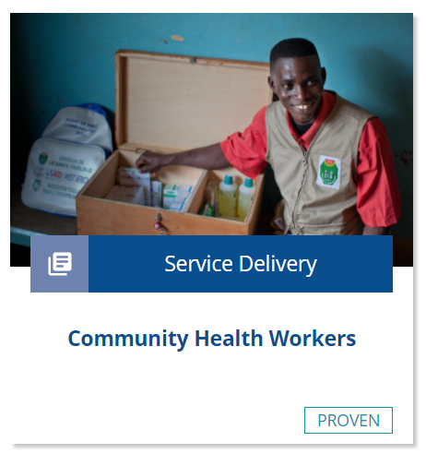
Implementation Tips
Address stigma and social and community barriers.
Engage communities and community health workers.
Engage support networks.
Postabortion Family Planning
17
Notes:
Address stigma and social and community barriers.
Offering family planning counseling and voluntary contraception to all postabortion clients – both those seeking treatment for miscarriage and those seeking treatment for induced abortion – helps reduce that potential stigma.
Engage communities and community health workers.
For more information about community health workers, please copy and paste this link into your web browser to visit the HIP Brief on Community Health Workers: https://www.fphighimpactpractices.org/briefs/community-health-workers/
A key approach is to engage communities in dialogue to define the need for PAC services, design PAC services that fit within the community culture, and develop local ownership for ensuring equitable access to and quality of PAC.
Engage support networks
Many women want their partner, husband, or other support person present for PAC counseling.
For more information about engaging men, please copy and paste this link into your web browser to visit the HIP strategic planning guide on Engaging Men and Boys in Family Planning: https://www.fphighimpactpractices.org/guides/engaging-men-and-boys-in-family-planning/
After discussing the client’s preferences, including loved ones in counseling and clinical instruction as been shown to improve adherence to care instruction.

Slide 18
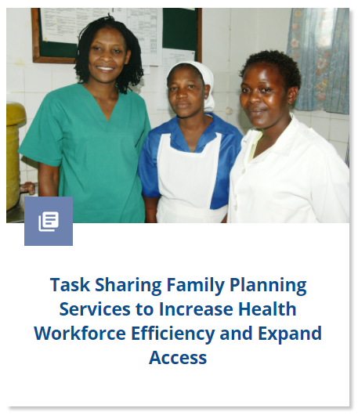
Implementation Tips
Offer PAC at primary care facilities and allow nurses and midwives to provide care in order to expand access and reduce costs.
Address the needs of PAC clients facing gender-based violence.
Make contraception free or bundle it with the cost of postabortion treatment.
Postabortion Family Planning
18
Notes:
Offer PAC at primary care facilities and allow nurses and midwives to provide care in order to expand access and reduce costs.
Trained, competent nurses and midwives can provide PAC services safely.
Task-sharing policies that expand the range of health care workers who can provide PAC, including family planning, may result in cost savings for the health system by reducing the work load at tertiary care facilities.
Task sharing may also result in savings for clients by making services more convenient and easier to access.
Some studies have shown that establishing family planning as part of PAC services is easier in places where midwives are responsible for all reproductive health services.
For more information about task-sharing, please copy and paste this link into your web browser to visit the strategic planning guide on Task Sharing Family Planning Services: https://www.fphighimpactpractices.org/guides/task-sharing-family-planning-services/
Address the needs of PAC clients facing gender-based violence.
Multiple studies highlight the relationship between gender-based violence and the increased risk of spontaneous abortion and/or increased likelihood to seek induced abortion.
Addressing these particular needs within PAC services requires training health care providers on how to identify survivors of intimate partner violence and sexual violence and respond to their needs.
Make contraception free or bundle it with the cost of postabortion treatment.
For adolescents and other vulnerable women, costs contribute to delays in seeking PAC as well as in accessing family planning before discharge from the facility.
For more information about improving sexual and reproductive health of young people, please copy and paste this link into your web browser to visit the HIP brief on Adolescents: https://www.fphighimpactpractices.org/briefs/adolescent-responsive-contraceptive-services/
Free contraception, waivers for poor and vulnerable clients, and streamlined payment systems are likely to enhance equitable access to contraception for PAC clients.

Slide 19

Implementation Tips
Invest in quality.
Offer a wide range of contraceptive methods.
Encourage and support providers to treat all clients respectfully.
Link clients to resources for ongoing support.
Postabortion Family Planning
19
Notes:
Invest in quality. Some of the elements of quality care include the following:
Offer a wide range of contraceptive methods
Offering a wide range of methods, including long-acting methods, is likely to increase voluntary family planning uptake.
Encourage and support providers to treat all clients respectfully
Such support often includes, but is not limited to, provider training and values clarification to address provider bias.
Training should be reinforced through supportive supervision, job descriptions, operational guidelines and policies, and other types of institutional support.
Link clients to resources for ongoing support
After initiating a contraceptive method, provide clients with information on where to access ongoing support and resupply, if necessary.
Digital technologies, hotlines, and community health workers may provide additional means to support clients.
For more information, please copy and paste this link into your web browser to visit the related HIP brief: https://www.fphighimpactpractices.org/briefs/digital-health-sbc/
Health workers should be sensitive to client preferences and respectful of client privacy.

Slide 20
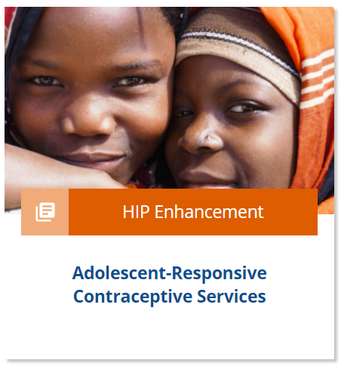
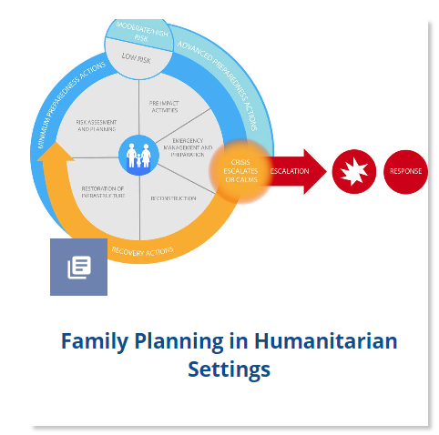
Implementation Tips
Ensure equitable access to postabortion contraception, regardless of:
Client’s age,
Local contexts, and
The type of evacuation procedure received.
Postabortion Family Planning
20
Notes:
Ensure equitable access to postabortion contraception, regardless of:
Client’s age
Specialized training on youth-friendly PAC was associated with a sustained greater voluntary uptake of contraception among young women in Ethiopia when compared with standard training.
For more information about improving sexual and reproductive health of young people, please copy and paste this link into your web browser to visit the HIP brief on Adolescents: https://www.fphighimpactpractices.org/briefs/adolescent-responsive-contraceptive-services/
Local contexts
In humanitarian settings, women and girls may be at increased risk of unintended pregnancy and unsafe abortion. For more information, please copy and paste this link into your web browser to visit the strategic planning guide on family planning in humanitarian settings: https://www.fphighimpactpractices.org/guides/family-planning-in-humanitarian-settings/
Furthermore, they may not be able to continue with their contraceptive method as it was lost during displacement.
Research has documented that approximately one in five women in complex humanitarian settings experienced sexual violence, which is likely an underestimate.
The type of evacuation procedure received
All contraceptives, with a few exceptions, can be offered after surgical or medical evacuation for treating complications (see BOX 1 in Postabortion FP brief and below for full list).
Family planning services should be offered to all postabortion clients on-site irrespective of evacuation procedure as an integral part of PAC.
Box 1. Contraceptive Methods for Postabortion Care
Can start immediately:
• Hormonal methods: implants, monthly injectables, injectables, combined oral contraceptive pills, progestin-only pills, progestin-only injectables, combined patch, emergency contraceptive pills.
• Barrier methods: male or female condoms.
• Intrauterine devices (IUDs): copper-bearing or levonorgestrel-releasing. These can be provided immediately after emergency treatment of complications if there is no infection—or when infection is ruled out and resolved, and any injury has healed. However, IUD insertion following medical treatment of emergency complications requires the patient to return for a follow-up visit.
• Diaphragms, cervical caps, and combined vaginal ring: can be offered once injury is ruled out or after any injury to the genital tract has healed.
• Permanent methods: tubal ligation or vasectomy (for her partner). Permanent methods can be offered after the client has had time to rest and recover from any sedation, and is not stressed or in pain. Counsel carefully and be sure to mention available reversible methods.
Delay use:
• Fertility awareness methods: Standard Days Method or TwoDay Method. It is recommended that women start these methods after their regular menstrual pattern returns.

Slide 21



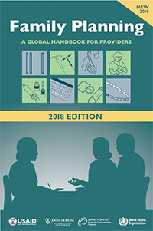
Tools & Resources
Family Planning: A Global Handbook for Providers
Postabortion Care e-learning course
Postabortion Care Resource site
05
Postabortion Family Planning
21
Notes:
Postabortion Care e-learning course (published May 2018) provides an overview of postabortion care including its definition, objectives, justification, programming best practices, indicators for monitoring and evaluation, and strong evidence base, including evidence-based approaches to strengthen postabortion family planning. Available in English from https://www.globalhealthlearning.org/course/postabortion-care-pac.
Postabortion Care resource site is a one-stop source for basic instruments to assist policy makers, program managers, clinical staff, and donors in program design, implementation, and evaluation. Available in English, French, Russian, and Spanish from http://www.postabortioncare.org/.
Family Planning: A Global Handbook for Providers (2018 edition) includes a section on family planning in postabortion care. Users can download printable files or order a copy of the handbook at https://www.fphandbook.org/
Bonus resource: Use of the WHO Guidelines & Tools alongside service delivery High Impact Practices in family planning. The tool focuses on Service Delivery HIPs and selected WHO Guidelines related to family planning service delivery. The tool is intended to be a quick reference for program managers designing or implementing family planning programs. The tool can be used to help improve implementation of HIPs by illustrating how to incorporate WHO evidence-based guidelines and/or can be used to support advocacy efforts for HIPs by linking them with globally recognized and credible WHO Guidelines. Please copy and paste this link into your web browser to visit: https://www.fphighimpactpractices.org/ibp-who-matrix/

Slide 22

fphighimpactpractices.org
Notes:
Subscribe to the HIPs Newsletter here (copy and paste this link into your web browser): https://mailchi.mp/76703a3652c9/hips-newsletter-sign-up
Please visit the five areas of our website to learn more about the HIPs:
HIP Products (copy and paste this link into your web browser): https://www.fphighimpactpractices.org/hip-products/
Resources (copy and paste this link into your web browser): https://www.fphighimpactpractices.org/resources/
Engage (copy and paste this link into your web browser): https://www.fphighimpactpractices.org/engage-with-the-hips/
Overview (copy and paste this link into your web browser): https://www.fphighimpactpractices.org/overview/
About Us (copy and paste this link into your web browser): https://www.fphighimpactpractices.org/partnership-structure/

