Slide 1




Mobile Outreach Services
Expanding access to a full range of modern contraceptives
Notes:
This brief describes the role of mobile outreach programs as a means of reducing inequities in access to family planning services (particularly long-acting reversible contraceptives and permanent methods – LARCs and PMs), discusses the potential contribution of these programs and outlines key issues for planning and implementation.
Photo Credit: © 2016 Laura Wando, WellShare International Uganda, Courtesy of Photoshare
REVISED: 5/4/21

Slide 2
Overview
What is a HIP?
HIP Categories
Partnership
Introduction to the High Impact Practices (HIPs)
PART
Background
What challenges can this HIP help address?
Evidence of Impact
PART
Mobile Outreach Services
Extra Slides
Various Models of Mobile Outreach
Implementation Tips
Tools & Resources
11
Mobile Outreach Services
02
Notes:
Thank you for using this slide deck! This is a product derived from the HIP brief to assist you in presenting to a variety of audiences. Instructions and additional resources are included in the notes of each slide for your convenience. There is a wealth of information and resources in the “Notes” section of each slide.
This presentation is divided in three parts: an Introduction to the High Impact Practices (HIPs) in Family Planning, Mobile Outreach Services, and Extra Slides.
The logo for your organization or ministry may be added to these slides. The web addresses provided in the “Notes” section of each slide can be copied and pasted into your web browser.

Slide 3



High Impact Practices in Family Planning (HIPs) are…
Evidence-based family planning practices
Vetted by experts against specific criteria
Documented in an easy-to-use format
Mobile Outreach Services
03
Notes:
High Impact Practices (HIPs) are a set of evidence-based family planning practices vetted by experts against specific criteria and documented in an easy-to-use format.
The High Impact Practices in Family Planning (HIPs) were first created in 2010 after a survey of FP stakeholders revealed little consensus for “what works” in international FP programming. A small group of leaders in FP were brought together with the task of identifying a short list of HIPs that if implemented at scale would help countries address the unmet need for FP and thereby increase national contraceptive prevalence.
HIPs are identified based on demonstrated magnitude of impact on contraceptive use and potential application in a wide range of settings. Consideration is also given to other relevant outcome measures including unintended pregnancy, fertility, or one of the primary proximate determinants of fertility (delay of marriage, birth spacing, or breast feeding). Evidence of replicability, scalability, sustainability, and cost-effectiveness are also considered.
For more information, please copy and paste this link into your web browser to see this video: https://www.youtube.com/watch?v=N6V0gfl-V3k&ab_channel=KnowledgeSUCCESS
A 2-pager overview of the HIPs is available in an online and a downloadable PDF format here (copy and paste this link into your web browser): https://www.fphighimpactpractices.org/high-impact-practices-in-family-planning-list/

Slide 4
HIPs address the full spectrum of FP programming
Enabling Environment
Service Delivery
Social and Behavioral Change
PART
Address systemic barriers that affect an individual’s ability to access family planning information & services. 6 briefs
Improve the availability, accessibility, acceptability, and quality of family planning services. 8 briefs
Influence knowledge, beliefs, behaviors, and social norms associated with family planning.
3 briefs
Enhancements
Approaches used in conjunction with HIPs to maximize the impact of HIP implementation or increase the reach. 4 briefs
Mobile Outreach Services
04
Notes:
There are three categories of HIPs: Enabling Environment, Service Delivery and Social and Behavioral Change. Mobile Outreach Services is a service delivery HIP. This information came from the HIP List (copy and paste this link into your web browser): https://www.fphighimpactpractices.org/high-impact-practices-in-family-planning-list/
A HIP Enhancement is a tool or approach that is not a standalone practice, but it is often used in conjunction with HIPs to maximize the impact of HIP implementation or increase the reach and access for specific audiences. The intended purpose and impact of enhancements are focused and, therefore the evidence-based and impact of an enhancement is subjected to different standards than a HIP.
For more information about the HIP Categories and Enhancements, please copy and paste this link into your web browser: https://www.fphighimpactpractices.org/high-impact-practices-in-family-planning-list/
Here are a few examples of HIPs from each category:
Service Delivery:
Immediate Postpartum Family Planning
Mobile Outreach Services
Postabortion Family Planning
Enabling Environment:
Domestic Public Financing
Educating Girls
Supply Chain Management
Social and Behavior Change:
Community Group Engagement
Digital Health for SBC
Mass Media
Enhancements:
Digital Health for Systems
Adolescent-Friendly Contraceptive Services
Family Planning Vouchers
All HIPs are Available in English, Spanish, French, and Portuguese.

Slide 5





HIP Partnership
The Technical Advisory Group (TAG) is made up of 25 experts in family planning, including representatives from the co-sponsors.
The Co-sponsors include the following organizations:
Mobile Outreach Services
05
Notes:
The High Impact Practices in Family Planning (HIPs) are supported by over 65 organizations. These organizations play a vital role in developing, reviewing, disseminating, and implementing HIPs in family planning.
The HIPs partnership includes various structures to ensure HIP products are developed, kept up to date, and disseminated widely. These include:
Co-sponsors – Serve as the secretariat for the HIPs.
Partners – Contribute to key HIP products and endorse the HIPs.
Technical Advisory Group – Ensure high technical quality of key HIP products and approve HIP brief and SPG concepts for development.
P&D Team – Support the production and dissemination (P&D) of HIP products.
Technical Expert Groups – Write new HIP briefs and ensure they are up-to-date.
For more information about the HIP Partnership, please copy and paste this link into your web browser: https://www.fphighimpactpractices.org/partnership-structure/

Slide 6
High Impact Practice
Support mobile outreach service delivery to provide a wide range of contraceptives, including long-acting reversible contraceptives and permanent methods.
Mobile Outreach Services
06
Notes:
This brief describes the role of mobile outreach programs as a means of reducing inequities in access to family planning services (particularly long-acting reversible contraceptives and permanent methods – LARCs and PMs), discusses the potential contribution of these programs and outlines key issues for planning and implementation.
For more information about Service Delivery HIPs, please copy and paste this link into your web browser to visit this matrix of tools developed by IBP/WHO: https://www.fphighimpactpractices.org/ibp-who-matrix/
These tools can be used in conjunction with Service Delivery HIPs.
Available in online and downloadable PDF format.
Did you know that we have a webinar recording and downloadable PDF presentation about this HIP? Please copy and paste this link into your web browser to visit: https://www.fphighimpactpractices.org/mobile-outreach-services-addressing-inequities-in-access-to-family-planning-services-and-commodities-webinar/
This webinar contains recent implementation successes in several country contexts.
Presenters:
Marguerite Farrell, USAID/GH/PRH/Service Delivery Improvement Division
Tom Ellum, MSI (formerly Marie Stopes International)
Ibrahim Muhammad Ibrahim, Planned Parenthood Federation of Nigeria (PPFN)
Eva Ros (facilitator), FP2030

Slide 7
Background
Mobile outreach services address inequities in access to family planning services and commodities in order to help women and men meet their reproductive health needs.
Outreach models allow for flexible and strategic deployment of resources to areas in greatest need at intervals that most effectively meet demand.
Long-acting reversible contraceptives (LARCs) and permanent methods (PMs) are typically unavailable in most rural or hard-to-reach areas.
Mobile Outreach Services
07
Notes:
Long-acting reversible contraceptives (LARCs) and permanent methods (PMs) are typically unavailable in most rural or hard-to-reach areas due to lack of skilled providers, commodities, and equipment.
Mobile outreach service delivery addresses these access barriers by bringing information, services, contraceptives, and supplies to where women and men live and work, generally free-of-charge or at a subsidized rate.
For more information, please copy and paste this link into your web browser to reference the “Background” section on the HIP brief:
https://www.fphighimpactpractices.org/briefs/mobile-outreach-services/

Slide 8
What challenges can this HIP help countries address?
Mobile outreach services serve communities with limited access to clinical providers and supplies.
Mobile outreach supports capacity building of providers to deliver LARCs and PMs.
Mobile Outreach Services
08
Notes:
Mobile outreach services serve communities with limited access to clinical providers and supplies.
Populations residing in rural areas, urban slums, and marginalized communities experience either geographic or economic barriers to qualified health workers, which contribute to large inequities in health outcomes and use of health services.
In addition to deploying trained clinical providers, mobile outreach service delivery models ensure a reliable supply of contraceptive commodities, medical supplies, and equipment needed to deliver a full range of family planning options.
Mobile outreach supports capacity building of providers to deliver LARCs and PMs.
Regular visits by mobile outreach service providers to under-resourced health facilities offer opportunities for on-the-job training and reinforcement of clinical and counseling skills, infection prevention measures, and management of client flow.

Slide 9

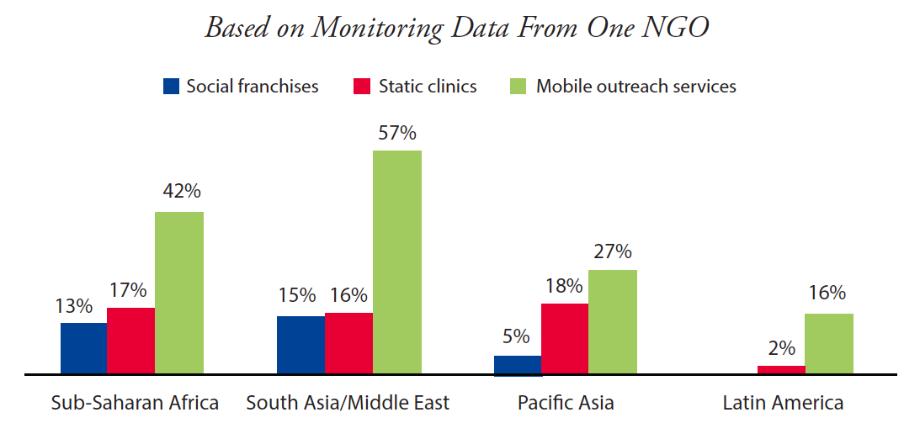
What challenges can this HIP help countries address?
Proportion of Family Planning Clients Living on Less Than US$1.25 Per Day, by Service Delivery Channel
Mobile outreach services reach new and underserved populations by bringing health services closer to the client.
Source: Hayes et al., 2013
05
Mobile Outreach Services
09
Notes:
Mobile outreach services reach new and underserved populations by bringing health services closer to the client.
Mobile outreach service clients are likely to be new to family planning.
Along with other service delivery channels, mobile outreach offers an effective way to also reach the poor.
Along with other service delivery channels, mobile outreach offers an effective way to also reach the poor. For example, in sub-Saharan Africa in 2012, 42% of mobile outreach clients of one international nongovernmental organization (NGO) lived on less than US$1.25 per day, compared with 17% and 13% of clients of static clinics and social franchises, respectively (Figure 1).
Please copy and paste this link into your web browser to view Figure 1 in the HIP brief: https://www.fphighimpactpractices.org/briefs/mobile-outreach-services/

Slide 10

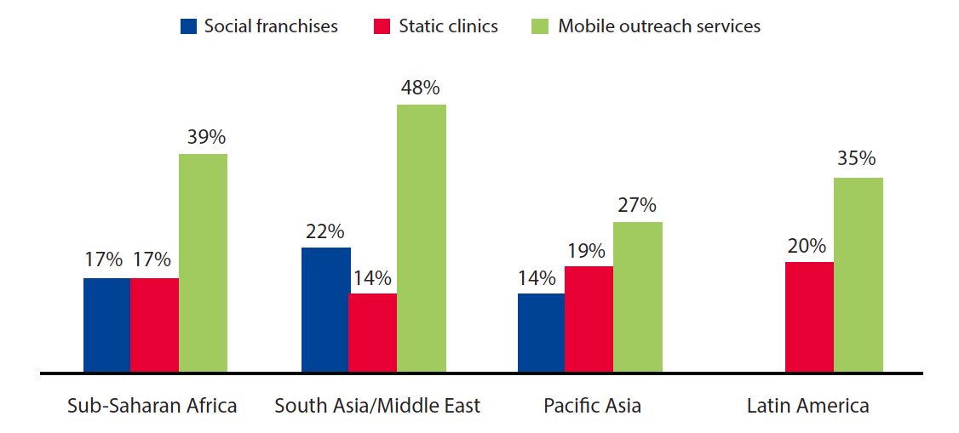
What challenges can this HIP help countries address?
Proportion of Clients Switching From Short-Acting to Long-Acting or Permanent Methods, by Service Delivery Channel, 2012
Mobile outreach services expand method choice.
Source: Hayes et al., 2013
05
Mobile Outreach Services
10
Notes:
Mobile outreach services expand method choice.
Specifically, mobile outreach services enable access to LARCs and PMs, which are less accessible in many developing-country health systems.
Service statistics from one international NGO indicate that mobile outreach services may increase opportunities for family planning clients to switch to LARCs or PMs to meet their stated reproductive intentions (Figure 2).
Please copy and paste this link into your web browser to view Figure 2 in the HIP brief: https://www.fphighimpactpractices.org/briefs/mobile-outreach-services/

Slide 11
Evidence of Impact
Mobile outreach can increase contraceptive use.
Cost-effectiveness should be evaluated when designing a mobile outreach program.
Mobile outreach services can provide high-quality care.
05
Mobile Outreach Services
11
Notes:
Mobile outreach can increase contraceptive use.
Evidence from a recent evidence review suggests that outreach and community-based distribution are “effective and acceptable ways of increasing access to contraceptives, particularly injectables and long-acting and permanent methods” (Mulligan et al., 2010).
When implemented at scale, and with attention to providing high-quality services, communities served by mobile outreach services increase use of modern contraceptives.
The Mobile Outreach Services HIP brief contains highlights from implementation studies in Zimbabwe, Nepal, Malawi, Northern Uganda, and Tanzania. For more information, please copy and paste this link into your web browser: https://www.fphighimpactpractices.org/briefs/mobile-outreach-services/
Cost-effectiveness should be evaluated when designing a mobile outreach program.
A prospective economic analysis of service delivery in Ethiopia comparing the cost-effectiveness of outreach by clinical specialists with provision of the same services through a referral system found that outreach was 1.45 times more cost-effective in using scarce clinical specialists’ time than the referral system (Kifle and Nigatu, 2010).
In Tunisia, a study concluded that although one-fourth of the national family planning operating budget supported the mobile outreach program, the mobile units contributed one-third of the total output of the national program.
More importantly, the mobile units contributed an even greater share of the national program’s activities in rural areas and played a critical role in expanding the geographic coverage of family planning services (Coeytaux et al., 1989).
It is important to note that cost-effectiveness may not translate to other health services and that there is little information on long-term financial sustainability.
Mobile outreach services can provide high-quality care.
A study in Nepal concluded that female sterilization services provided through mobile outreach and in hospitals were comparable in terms of client screening and quality of care (Thapa and Friedman, 1998).
Observational studies in India found that incidence of side effects and complications for clients receiving IUDs or sterilization services through mobile services were similar to rates in published literature (Aruldas et al., 2013).

Slide 12
Thank You
Continue to the extra slides or access the HIP brief for more information.
Mobile Outreach Services
12
Notes:
For more information, please copy and paste this link into your web browser to visit this webpage with a recording of the webinar on Mobile Outreach Services and a downloadable PDF version of the presentation: https://www.fphighimpactpractices.org/mobile-outreach-services-addressing-inequities-in-access-to-family-planning-services-and-commodities-webinar/

Slide 13
Extra Slides
Models of Mobile Outreach Service Delivery
Implementation Tips
Tools & Resources
Mobile Outreach Services
13
Notes:
We have put together a collection of implementation tips for mobile outreach services, in case you have additional time in your meeting. Further information about these tips can be found in the HIP brief.
References from the literature on this HIP can be found here (copy and paste this link into your web browser): https://www.fphighimpactpractices.org/wp-content/uploads/2018/08/MobileOutreachServices_references.pdf

Slide 14
Various Models of Mobile Outreach
More Resource-Intensive ↔ Less Resource-Intensive
Classic
Streamlined
Dedicated Provider
The “classic” model uses a team of clinical providers that travels to communities in a mobile clinic or that sets up a clinic in temporary settings, representing the most resource-intensive model.
The “dedicated provider” model involves a single provider who focuses on providing contraceptives, particularly LARCs and/ or PMs, and is embedded in an existing health facility.
Mobile Outreach Services
14
Notes:
Various models of mobile outreach service delivery have been implemented successfully at large scale.
Table 1 in the HIP brief describes the range of models used for mobile outreach service delivery. The “classic” model uses a team of clinical providers that travels to communities in a mobile clinic or that sets up a clinic in temporary settings, representing the most resource-intensive model. On the other hand, the “dedicated provider” model involves a single provider who focuses on providing contraceptives, particularly LARCs and/ or PMs, and is embedded in an existing health facility. This model is usually less resource-intensive than other models.
For more information about the various models of mobile outreach service delivery, please copy and paste this link into your web browser to reference Table 1 in the “How to do it: Tips from implementation experience” section on the HIP brief: https://www.fphighimpactpractices.org/briefs/mobile-outreach-services/

Slide 15

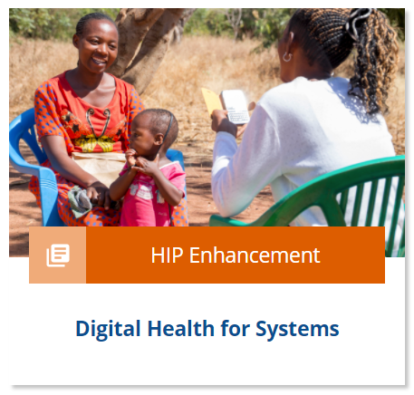
Implementation Tips
Coordinate with community leaders to identify appropriate locations.
Map the geographic area.
Ensure that sites are clean, safe, and private.
Develop effective public-private partnerships.
Mobile Outreach Services
16
Notes:
Coordinate with community leaders to identify appropriate locations.
Distance from a service provider is not always the primary barrier for clients with unmet need for family planning.
Mobile outreach services can be successfully deployed to address unmet need in rural as well as urban areas.
Coordination with local government well in advance of outreach visits helps ensure that selected sites have appropriate space and that site staff are committed to accommodating space and other needs of the mobile team.
Map the geographic area.
Mapping the location of focus communities within an outreach catchment area will enable service providers to identify appropriate outreach sites and effectively plan and schedule the mobile team’s visit.
For more information about new technologies, please copy and paste this link into your web browser to visit the Digital Health HIP brief: https://www.fphighimpactpractices.org/briefs/digital-health-systems/
Ensure that sites are clean, safe, and private.
Any site used for mobile outreach services needs to be safe and clean, and it needs to provide space for privacy during counseling, the procedure, and recovery.
Adequate space can be a significant barrier for effective outreach service delivery.
Develop effective public-private partnerships.
Mobile outreach service arrangements allow Ministries of Health and NGOs to work together in order to expand the reach of both partners to meet national health goals.
An increasing number of countries are experimenting with contracting relationships that position mobile outreach as an integral part of the health system.
These relationships leverage the clinical skills and geographic flexibility of private/NGO providers while allowing Ministries of Health to guide priority setting and allocation of resources.

Slide 16
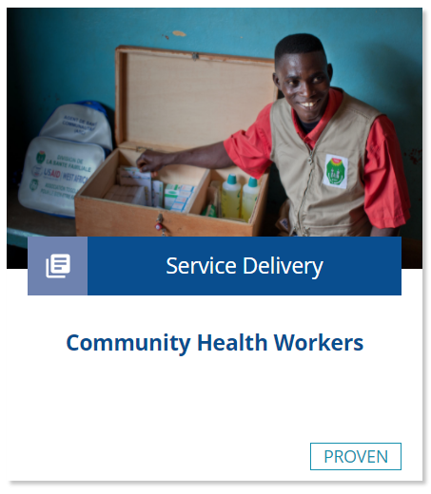
Implementation Tips
Recruit and support dedicated staff.
Invest in sustained awareness-raising and communication activities.
Link outreach programs with CHWs and local clinics for family planning counseling, referrals, and community mobilization.
Anticipate and address challenges.
Mobile Outreach Services
17
Notes:
Recruit and support dedicated staff.
Staff may be engaged on a part-time or full-time basis or may offer outreach services as part of their regular jobs.
Staff work plans and schedule rotations should be reviewed regularly, and travel dates should be set in advance so that the arrival of the mobile team is predictable for both clients and providers.
Invest in sustained awareness-raising and communication activities.
Clients in underserved communities often lack knowledge about family planning and have limited exposure to media and communication channels (Mwaikambo, 2011).
Clients of mobile outreach services frequently report that they first heard of the program either through word-of-mouth (friends, relatives, and satisfied clients), community health workers (CHWs), loudspeakers, radio, and community events (Eva and Ngo, 2010).
Link outreach programs with CHWs and local clinics for family planning counseling, referrals, and community mobilization.
CHWs typically live in the community they serve and are generally selected by the communities in which they operate. As a result, CHWs often have strong local networks and knowledge.
Mobile outreach programs often engage CHWs to communicate the location and dates of mobile outreach service days.
CHWs conduct demand generation, education activities, and basic family planning counseling a few days prior to the visit of the mobile outreach team. For more information about CHWs, please copy and paste this link into your web browser to visit the Community Health Workers HIP brief: https://www.fphighimpactpractices.org/briefs/community-health-workers/
Anticipate and address challenges.
Potential changes range from transportation difficulties and logistics issues to client misinformation about family planning and ensuring follow-up care.
Anticipating these challenges in advance and making plans for how to address them if they arise will help ensure mobile outreach programs are successful.
Ensure Clients Have Access to Follow-up Care
• Work with CHWs to assist with follow up and to refer complications to higher levels of service.
• Use mobile phones and SMS for follow-up messaging.
• Use hotlines for information about follow-up care.
• Ensure mobile outreach teams are equipped to offer LARC removals, and ensure a strong referral network is in place to guarantee access to removals between visits.

Slide 17

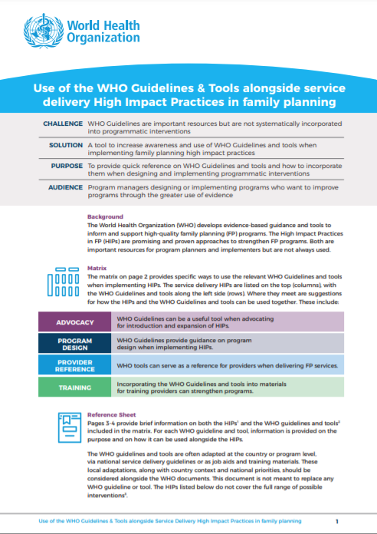
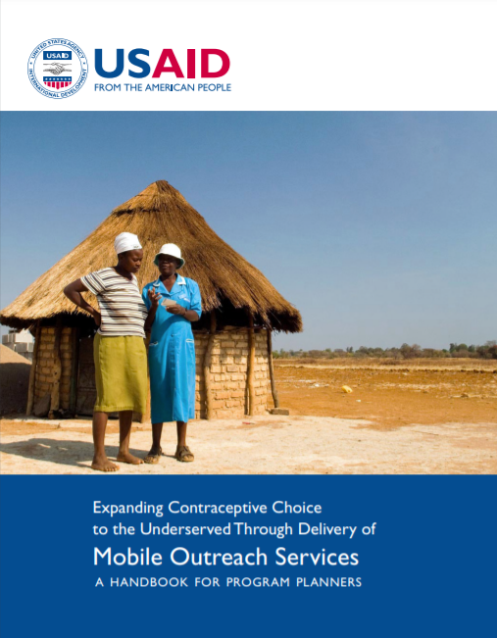
Tools & Resources
Expanding Contraceptive Choice to the Underserved Through Delivery of Mobile Outreach Services: A Handbook for Program Planners
Use of the WHO Guidelines & Tools Alongside Service Delivery High Impact Practices in Family Planning
05
Mobile Outreach Services
18
Notes:
Expanding Contraceptive Choice to the Underserved Through Delivery of Mobile Outreach Services: A Handbook for Program Planners provides general guidance on how to design and implement mobile outreach family planning services and should be adapted to each country’s context. This handbook includes two tools as appendices: (1) minimum guidelines for managing an outreach program, and (2) a sample partner agreement. Available from: https://toolkits.knowledgesuccess.org/toolkits/communitybasedfp/expanding-contraceptive-choice-underserved-through-delivery-mobile
Bonus resource: Use of the WHO Guidelines & Tools alongside service delivery High Impact Practices in family planning. The tool focuses on Service Delivery HIPs and selected WHO Guidelines related to family planning service delivery. The tool is intended to be a quick reference for program managers designing or implementing family planning programs. The tool can be used to help improve implementation of HIPs by illustrating how to incorporate WHO evidence-based guidelines and/or can be used to support advocacy efforts for HIPs by linking them with globally recognized and credible WHO Guidelines. Please copy and paste this link into your web browser to visit: https://www.fphighimpactpractices.org/ibp-who-matrix/

Slide 18

fphighimpactpractices.org
Notes:
Subscribe to the HIPs Newsletter here (copy and paste this link into your web browser): https://mailchi.mp/76703a3652c9/hips-newsletter-sign-up
Please visit the five areas of our website to learn more about the HIPs:
HIP Products (copy and paste this link into your web browser): https://www.fphighimpactpractices.org/hip-products/
Resources (copy and paste this link into your web browser): https://www.fphighimpactpractices.org/resources/
Engage (copy and paste this link into your web browser): https://www.fphighimpactpractices.org/engage-with-the-hips/
Overview (copy and paste this link into your web browser): https://www.fphighimpactpractices.org/overview/
About Us (copy and paste this link into your web browser): https://www.fphighimpactpractices.org/partnership-structure/

