Slide 1
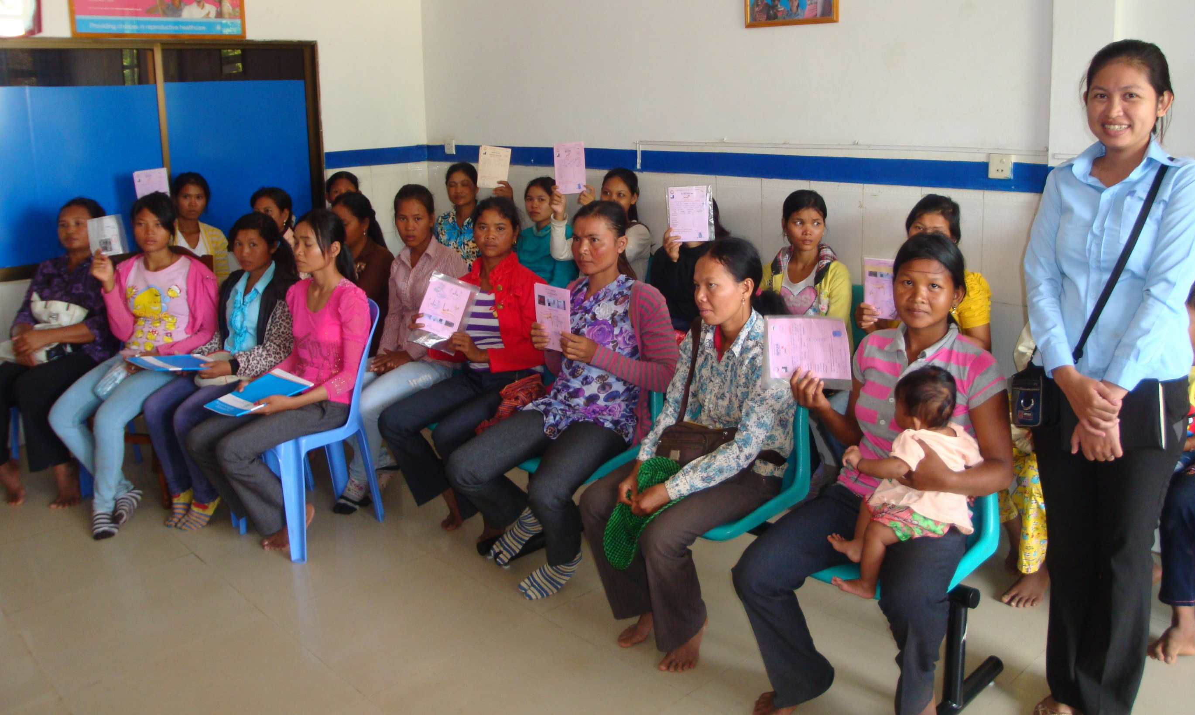



Family Planning Vouchers
A tool to boost contraceptive method access and choice.
Notes:
This brief discusses the potential contributions of vouchers to enhancing the quality and voluntary use of contraceptive services, outlines key issues for planning and implementation, and identifies knowledge gaps.
Photo Credits: © 2012 Marcel Reyners, Courtesy of Photoshare
REVISED: 5/4/21

Slide 2
Overview
What is a HIP?
HIP Categories
Partnership
Introduction to the High Impact Practices (HIPs)
PART
PART
Background
How voucher programs work
Theory of Change
How can vouchers enhance HIPs?
Recommended Indicator
Family Planning Vouchers
Priority Research Questions
Implementation Tips
Tools & Resources
Extra Slides
11
Family Planning Vouchers
02
Notes:
Thank you for using this slide deck! This is a product derived from the HIP brief to assist you in presenting to a variety of audiences. Instructions and additional resources are included in the notes of each slide for your convenience. There is a wealth of information and resources in the “Notes” section of each slide.
This presentation is divided in three parts: an Introduction to the High Impact Practices (HIPs) in Family Planning, Family Planning Vouchers, and Extra Slides.
The logo for your organization or ministry may be added to these slides. The web addresses provided in the “Notes” section of each slide can be copied and pasted into your web browser.

Slide 3



High Impact Practices in Family Planning (HIPs) are…
Evidence-based family planning practices
Vetted by experts against specific criteria
Documented in an easy-to-use format
Family Planning Vouchers
03
Notes:
High Impact Practices (HIPs) are a set of evidence-based family planning practices vetted by experts against specific criteria and documented in an easy-to-use format.
The High Impact Practices in Family Planning (HIPs) were first created in 2010 after a survey of FP stakeholders revealed little consensus for “what works” in international FP programming. A small group of leaders in FP were brought together with the task of identifying a short list of HIPs that if implemented at scale would help countries address the unmet need for FP and thereby increase national contraceptive prevalence.
HIPs are identified based on demonstrated magnitude of impact on contraceptive use and potential application in a wide range of settings. Consideration is also given to other relevant outcome measures including unintended pregnancy, fertility, or one of the primary proximate determinants of fertility (delay of marriage, birth spacing, or breast feeding). Evidence of replicability, scalability, sustainability, and cost-effectiveness are also considered.
For more information, please copy and paste this link into your web browser to see this video: https://www.youtube.com/watch?v=N6V0gfl-V3k&ab_channel=KnowledgeSUCCESS
A 2-pager overview of the HIPs is available in an online and a downloadable PDF format here (copy and paste this link into your web browser): https://www.fphighimpactpractices.org/high-impact-practices-in-family-planning-list/

Slide 4
HIPs address the full spectrum of FP programming
Enabling Environment
Service Delivery
Social and Behavioral Change
PART
Address systemic barriers that affect an individual’s ability to access family planning information & services. 6 briefs
Improve the availability, accessibility, acceptability, and quality of family planning services. 8 briefs
Influence knowledge, beliefs, behaviors, and social norms associated with family planning.
3 briefs
Enhancements
Approaches used in conjunction with HIPs to maximize the impact of HIP implementation or increase the reach. 4 briefs
Family Planning Vouchers
04
Notes:
There are three categories of HIPs: Enabling Environment, Service Delivery and Social and Behavioral Change. Family Planning Vouchers is an Enhancement HIP. This information came from the HIP List (copy and paste this link into your web browser): https://www.fphighimpactpractices.org/high-impact-practices-in-family-planning-list/
A HIP Enhancement is a tool or approach that is not a standalone practice, but it is often used in conjunction with HIPs to maximize the impact of HIP implementation or increase the reach and access for specific audiences. The intended purpose and impact of enhancements are focused and, therefore the evidence-based and impact of an enhancement is subjected to different standards than a HIP.
For more information about the HIP Categories and Enhancements, please copy and paste this link into your web browser: https://www.fphighimpactpractices.org/high-impact-practices-in-family-planning-list/
Here are a few examples of HIPs from each category:
Service Delivery:
Immediate Postpartum Family Planning
Mobile Outreach Services
Postabortion Family Planning
Enabling Environment:
Domestic Public Financing
Educating Girls
Supply Chain Management
Social and Behavior Change:
Community Group Engagement
Digital Health for SBC
Mass Media
Enhancements:
Digital Health for Systems
Adolescent-Friendly Contraceptive Services
Family Planning Vouchers
All HIPs are Available in English, Spanish, French, and Portuguese.

Slide 5





HIP Partnership
The Technical Advisory Group (TAG) is made up of 25 experts in family planning, including representatives from the co-sponsors.
The Co-sponsors include the following organizations:
Family Planning Vouchers
05
Notes:
The High Impact Practices in Family Planning (HIPs) are supported by over 65 organizations. These organizations play a vital role in developing, reviewing, disseminating, and implementing HIPs in family planning.
The HIPs partnership includes various structures to ensure HIP products are developed, kept up to date, and disseminated widely. These include:
Co-sponsors – Serve as the secretariat for the HIPs.
Partners – Contribute to key HIP products and endorse the HIPs.
Technical Advisory Group – Ensure high technical quality of key HIP products and approve HIP brief and SPG concepts for development.
P&D Team – Support the production and dissemination (P&D) of HIP products.
Technical Expert Groups – Write new HIP briefs and ensure they are up-to-date.
For more information about the HIP Partnership, please copy and paste this link into your web browser: https://www.fphighimpactpractices.org/partnership-structure/

Slide 6
High Impact Practice
Provide vouchers to clients to facilitate equitable access to and choice of voluntary contraceptive services.
Family Planning Vouchers
06
Notes:
This brief discusses the potential contributions of vouchers to enhancing the quality and voluntary use of contraceptive services, outlines key issues for planning and implementation, and identifies knowledge gaps.

Slide 7
Background
Vouchers for family planning can be:
Used to improve equitable access and increase the use of key health products and services.
Designed to improve client knowledge of contraceptive method options and inform potential clients where and when they can access services.
Used to support providers to improve the quality of their services through accreditation and to expand the range of contraceptive methods available.
Family Planning Vouchers
07
Notes:
Health care vouchers are paper or electronic referral coupons, often distributed in a community setting, that clients can take to an accredited provider in exchange for services.
Vouchers are a form of results-based financing, a type of health system reform that includes payment or non-monetary transfers after services have been delivered and verified. Payment to service providers is only issued when the services have been delivered in accordance with the voucher program standards and guidelines.
In settings where potential clients must pay for contraceptive services and/or methods, individuals (e.g., adolescents) may face financial barriers that restrict their ability to access and use some methods. Vouchers can reduce these financial barriers and facilitate client access to more contraceptive options. Vouchers that focus on specific population groups help ensure subsidies reach individuals who may be less likely to have access to and ability to use family planning services and products.
For more information, please copy and paste this link into your web browser to reference the “Background” section on the HIP brief: https://www.fphighimpactpractices.org/briefs/family-planning-vouchers/

Slide 8

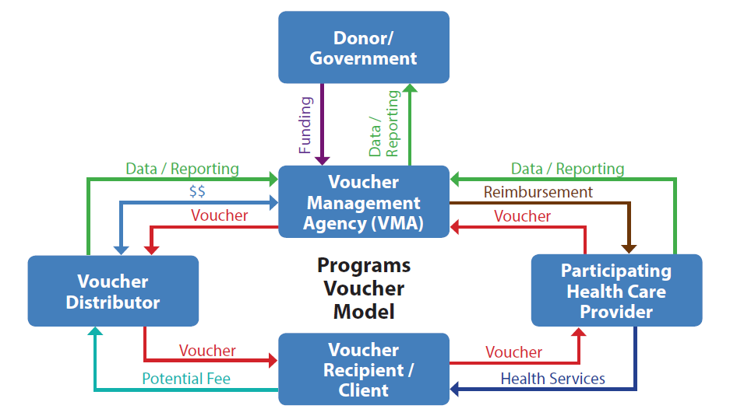
How voucher programs work
How Voucher Programs Work
Family Planning Vouchers
08
Notes:
Figure 1 depicts an illustrative example of how contraceptive voucher programs work.
Voucher programs typically include a fund processing body (voucher management agency), and an independent monitoring and oversight body (e.g., third-party verification agents or a governance board). Voucher programs typically contract private and/ or public providers who have met quality standards, and they engage community organizations to promote the program and distribute or sell vouchers to eligible, interested clients.
View Figure 1 in the HIP brief (copy and paste this link into your web browser): https://www.fphighimpactpractices.org/briefs/family-planning-vouchers/

Slide 9
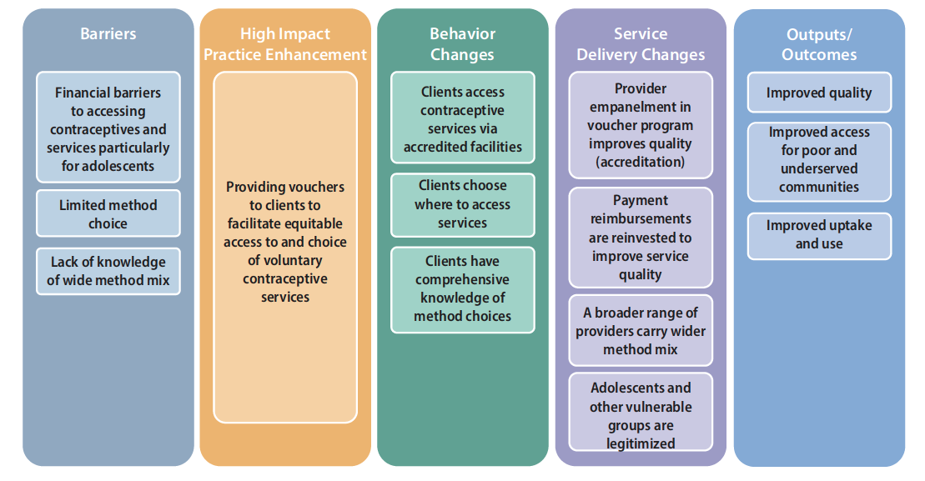
Theory of Change
05
Family Planning Vouchers
09
Notes:
View Figure 2 in the HIP brief (copy and paste this link into your web browser): https://www.fphighimpactpractices.org/briefs/family-planning-vouchers/

Slide 10

How can vouchers enhance HIPs?
How Vouchers Support HIP Implementation
HIPs | VOUCHERS ENHANCE THE PRACTICE BY… | COUNTRY EXAMPLES
Immediate Postpartum Family Planning | Supporting integrated services by targeting single or multiple related health care service in addition to voluntary family planning services. | A voucher program in Yemen covered both maternity and family planning services while in India, it included antenatal care, delivery, postnatal care, and family planning services.
Social Franchising | Supporting client-centered access to contraceptive products and services including adolescent-friendly contraceptive services, through preferred and convenient service delivery points including the private sector. | In Kenya, voucher holders could seek services at their choice of participating private, public, and/or nonprofit clinics. In Madagascar, a voucher program invested in building capacity of private franchised facilities to offer services for sexually transmitted infections and family planning and to serve youth.
Community Health Workers SBC Overview Mass Media | Disseminating key information about contraceptives, services, and how to access them, as well as addressing other nonfinancial barriers. | In Pakistan, a voucher program relied on community outreach workers to raise awareness and counsel about family planning to potential clients.
Domestic Public Financing | Improving efficiency of the use of domestic resources by targeting public funding of family planning to beneficiaries facing barriers to access, helping to overcome challenges for clients who are inclined to seek care, but lack motivating information. | Experience with the Vouchers for Health Programme (Kenya) is helping national policy makers prepare for a national social health insurance program. World Bank funds to countries have supported implementation of voucher programs in countries like Bangladesh, India, and Zimbabwe.
05
Family Planning Vouchers
10
Notes:
Vouchers can support implementation of a number of other HIPs (Table 1).
They can help family planning programs remove barriers and expand client access to more contraceptive options including those that may be too expensive or otherwise difficult for clients to access.
Studies in Jordan and Pakistan have documented significant community-level effects of voucher programs on mCPR.
View Table 1 in the HIP brief (copy and paste this link into your web browser): https://www.fphighimpactpractices.org/briefs/family-planning-vouchers/
For more information about the High-Impact Practices listed in Table 1, please copy and paste the following links into your web browser to visit the related HIP briefs:
Immediate Postpartum Family Planning: https://www.fphighimpactpractices.org/briefs/immediate-postpartum-family-planning/
Social Franchising: https://www.fphighimpactpractices.org/briefs/social-franchising/
Adolescent-Receptive Contraceptive Services: https://www.fphighimpactpractices.org/briefs/adolescent-responsive-contraceptive-services/
Community Health Workers: https://www.fphighimpactpractices.org/briefs/community-health-workers/
SBC Overview: https://www.fphighimpactpractices.org/briefs/sbc-overview/
Mass Media: https://www.fphighimpactpractices.org/briefs/mass-media/
Domestic Public Financing: https://www.fphighimpactpractices.org/briefs/domestic-public-financing/

Slide 11
How can vouchers enhance HIPs?
Facilitate client access to more contraceptive options
Even when family planning services are presumed to be free at point of care, subtle financial barriers may exist.
When a voucher program reduces or removes the client’s cost for provider-dependent methods, use of provider-dependent methods increases while use of other methods either remains the same or increases.
05
Family Planning Vouchers
11
Notes:
Facilitate client access to more contraceptive options
Even when family planning services are presumed to be free at point of care, subtle financial barriers may exist.
A systematic review concluded that “vouchers can expand client choice by reducing financial barriers to contraceptive services and make private providers an option for disadvantaged clients previously restricted by cost.”
Evidence from voucher programs consistently shows that when a voucher program reduces or removes the client’s cost for provider-dependent methods, use of provider-dependent methods increases while use of other methods either remains the same or increases.

Slide 12
How can vouchers enhance HIPs?
Improve access to contraceptives for key population groups
Most programs were successful in reaching subgroups, such as the poor and young consumers (under 25 years).
Vouchers can also reach other disadvantaged groups, such as those with little or no education.
05
Family Planning Vouchers
12
Notes:
Improve access to contraceptives for key population groups
A review of 24 NGO-supported voucher programs across 11 countries in Africa and Asia between 2005 and 2015 found that most programs were successful in reaching subgroups, such as the poor and young consumers (under 25 years).
In rural India, a voucher program contributed to an increase in mCPR among women living below the poverty line, from 33% to 43%. Similar results were noted from studies in Pakistan.
From 2013 to 2014 in Madagascar, a social franchising network offered vouchers for family planning and sexually transmitted infection (STI) services, in which 96% of clients were 20 years old or younger.
In Nicaragua, adolescent girls who obtained vouchers had 3.1 higher odds of using participating health centers compared to those who did not receive vouchers. Additionally, sexually active adolescents who received vouchers had twice the odds of using modern contraception, and 2.5 higher odds of reporting condom use at last sex compared with adolescents who did not obtain vouchers.
Vouchers can also reach other disadvantaged groups, such as those with little or no education.
In Uganda, where only 23% of women with no education and 34% of women with a primary education use a modern method, a voucher program facilitated family planning access for 330,826 women, 79% of whom had no education or only primary education.

Slide 13
How can vouchers enhance HIPs?
Facilitate access to private providers
Vouchers can enable access to health services in private facilities when public facilities are unable to provide services, including in fragile states.
Engaging the private sector can also expand geographic coverage and/or access to a wider choice of contraceptive methods.
05
Family Planning Vouchers
13
Notes:
Facilitate access to private providers
Some groups, like unmarried youth, may prefer accessing contraceptive services through private providers due to convenience, a perception of higher quality and greater confidentiality than in the public sector, or other factors.
Vouchers can expand access to the private sector for groups who may face access challenges due to prohibitive user fees, such as low-income individuals or adolescents.
For more information about Adolescent-Responsive Contraceptive Services, please copy and paste this link into your web browser to visit the related HIP brief: https://www.fphighimpactpractices.org/briefs/adolescent-responsive-contraceptive-services/
In addition, vouchers can enable access to health services in private facilities when public facilities are unable to provide services, including in fragile states.
For more information, please copy and paste this link into your web browser to visit the strategic planning guide on family planning in humanitarian settings: https://www.fphighimpactpractices.org/guides/family-planning-in-humanitarian-settings/
Engaging the private sector can also expand geographic coverage and/or access to a wider choice of contraceptive methods.

Slide 14
How can vouchers enhance HIPs?
Can drive service delivery improvements
A voucher accreditation process establishes standards of care and assists in developing the capacity of the voucher program to measure and monitor the quality of health services.
Voucher payments offer providers a steady flow of income that can be reinvested in improving services.
05
Family Planning Vouchers
14
Notes:
Can drive service delivery improvements
A voucher accreditation process establishes standards of care and assists in developing the capacity of the voucher program to measure and monitor the quality of health services.
Voucher payments offer providers a steady flow of income that can be reinvested in improving services.
In Kenya, 67% to 89% of providers used revenue from voucher payments to improve infrastructure, buy equipment or drugs and supplies, hire new or pay existing staff, or create patient amenities.
Voucher program health care providers in Nicaragua had better clinical knowledge, improved provider practices, and, to a lesser extent, improved provider attitudes toward adolescent use of family planning and STI services compared with providers not involved in the voucher program. Client satisfaction was significantly higher among adolescents using vouchers than among those without vouchers.
A study in Pakistan also noted improvement in quality standards in the provision of family planning information, services, and commodities, including the quality of counseling services, the method mix from which clients could choose, respect for clients’ privacy, and client satisfaction.

Slide 15

Recommended
Indicator
Percent of vouchers distributed that are redeemed by target groups
05
Family Planning Vouchers
15
Notes:
It is recommended that programs implementing family planning vouchers include the following indicators:

Slide 16
Thank You
Continue to the extra slides or access the HIP brief for more information.
Family Planning Vouchers
16
Notes:
For more information, please copy and paste this link into your web browser to visit the Family Planning Vouchers HIP brief: https://www.fphighimpactpractices.org/briefs/family-planning-vouchers/

Slide 17
Extra Slides
Priority Research Questions
Implementation Tips
Tools & Resources
Family Planning Vouchers
17
Notes:
We have put together a collection of implementation tips for Family Planning Vouchers, in case you have additional time in your meeting. Further information about these tips can be found in the HIP brief.
References from the literature on this HIP can be found here (copy and paste this link into your web browser): https://www.fphighimpactpractices.org/wp-content/uploads/2019/06/family-planning-vouchers-references-june-2020.pdf

Slide 18
Priority Research Questions
What are the costs of voucher programs, including voucher management, fraud detection, etc.?
Can selected characteristics of vouchers and voucher programs increase voucher redemption? (e.g., expiration dates, free vs. priced, single vs. multiple method)
05
Family Planning Vouchers
18
Notes:
These research questions, reviewed by the HIP technical advisory group, reflect the prioritized gaps in the evidence base specific to the topics reviewed in this brief and focus on the HIP criteria.

Slide 19

Implementation Tips
Voucher programs work best where:
Financial and other access barriers restrict access to contraceptives among a specific underserved client group.
Eligible clients can be accurately identified and effectively reached.
Adequate resources exist to implement vouchers at sufficient scale and over a long enough period of time to justify a fully functional voucher management system.
Factors contributing to failure of voucher programs:
Poor management of voucher distributors and inadequate attention to voucher distribution and marketing.
Provider reimbursement is not set appropriately to make up for the costs of delivering services.
Definition of what is included in the voucher service package is not clear to the provider and/or the client.
Family Planning Vouchers
19
Notes:
Voucher programs work best where:
Financial and other access barriers restrict access to contraceptives among a specific underserved client group.
Eligible clients can be accurately identified and effectively reached.
Adequate resources exist to implement vouchers at sufficient scale and over a long enough period of time to justify a fully functional voucher management system.
There is at least one, but optimally more, providers with the potential capacity to provide contraceptive services, including voluntary long-acting reversible contraceptives and permanent methods.
Robust supply-side mechanisms are in place to build and assure service quality, including sanctions for providers who do not meet quality standards.
Factors contributing to failure of voucher programs:
Poor management of voucher distributors and inadequate attention to voucher distribution and marketing
Provider reimbursement is not set appropriately to make up for the costs of delivering services.
Providers are not reimbursed in a timely manner for voucher services rendered.
Definition of what is included in the voucher service package is not clear to the provider and/or the client.
Ability to verify voucher service delivery is limited
Poor design of voucher program such that target groups are not optimally reached or services covered are not those desired by target groups

Slide 20
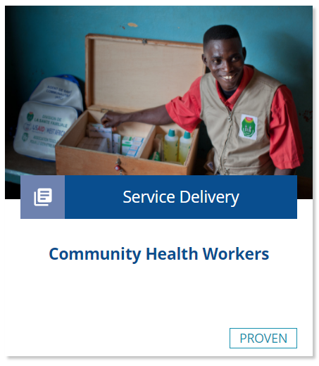
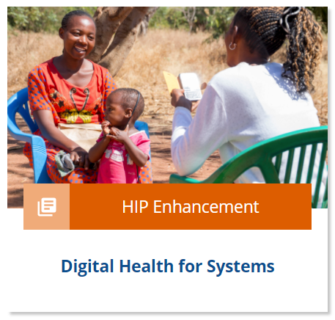
Implementation Tips
Reaching intended Beneficiaries
Invest in voucher distribution.
Develop clear, feasible eligibility criteria.
Family Planning Vouchers
20
Notes:
Reaching intended Beneficiaries
Invest in voucher distribution.
Voucher distribution involves identifying members of the client population in a way that is cost-effective, respectful of beneficiary confidentiality and needs, and timely for the beneficiary.
Consider working with existing digital platforms or community structures, such as community health workers (CHWs), particularly when trying to reach youth who may face social barriers to accessing services and adopting contraception.
Remuneration to CHWs should not incentivize promotion of particular contraceptive methods and can be mainstreamed into a well-rounded financial and non-financial remuneration strategy.
For more information about Community Health Workers (CHWs), please copy and paste this link into your web browser to visit the related HIP brief: https://www.fphighimpactpractices.org/briefs/community-health-workers/
Distributors need to be adequately trained using a client-centered approach that supports voluntary choice. While it can be challenging to implement, supportive supervision of community-level distribution is essential.
Client and provider-facing digital technologies, where appropriate such as facilitating client health education, client identification, provider payments, provider support or client follow up, may help.
For more information about Digital Health for Systems, please copy and paste this link into your web browser to visit the related HIP brief: https://www.fphighimpactpractices.org/briefs/digital-health-systems/
Develop clear, feasible eligibility criteria.
Poverty assessment tools are typically in the form of questionnaires and are used to assess eligibility for vouchers based on wealth assets (e.g., EquityTool.org).
Some countries, like India, use an established standard, such as the “below poverty line” or poverty card. Other programs demark geographic areas as poor or vulnerable communities, called geographic targeting.
Debate is ongoing about means testing, which can be expensive, time-consuming, and intrusive, and geographic targeting, which is less accurate but simpler and at lower cost.
Voucher programs are increasingly opting for geographic targeting alongside training of voucher distributors to identify eligible clients.

Slide 21

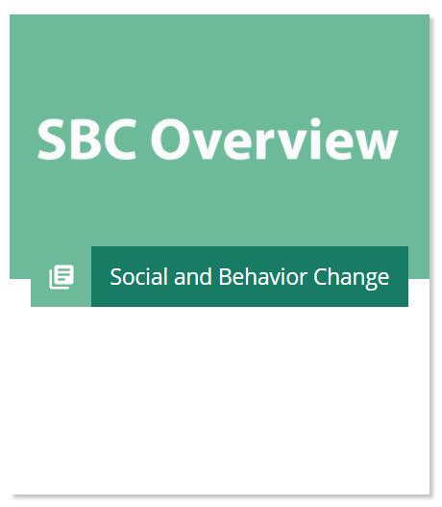
Implementation Tips
Reaching intended Beneficiaries
Vouchers should be designed using social and behavior change principles and best practices.
Consider whether to use paper vouchers or e-vouchers.
Family Planning Vouchers
21
Notes:
Reaching intended Beneficiaries
Vouchers should be designed using social and behavior change principles and best practices.
Vouchers constitute a key component of comprehensive demand generation that improves knowledge of and access to contraceptive methods among disadvantaged audience groups.
Promotion of voucher programs should be integrated into broader family planning campaign channels (e.g., mass media, digital, print, outreach, community forums) and messages to maximize reach.
For more information about social and behavior change, please copy and paste this link into your web browser to visit the SBC Overview: https://www.fphighimpactpractices.org/briefs/sbc-overview/
For more information about mass media, please copy and paste this link into your web browser to visit the related HIP Brief: https://www.fphighimpactpractices.org/briefs/mass-media/
Consider whether to use paper vouchers or e-vouchers.
As rates of mobile phone use increase, interest in electronic vouchers grows. However, recent experiences suggest caution in relying on e-vouchers because mobile phones may be owned by a household rather than an individual; both distributors and clients require reliable network coverage; and if contraceptive use is clandestine, messages relating to family planning may place beneficiaries in danger, make them uncomfortable, or not reach the intended beneficiary.
In Madagascar, adolescents either lacked access to a mobile phone or were concerned about confidentiality when e-vouchers were sent by phone. After adding a paper voucher option, voucher distribution increased rapidly.
The opportunity for digitizing some aspects of voucher distribution and use is growing as usage of mobile phones and digital platforms continues to expand and be adapted by wider swaths of LMIC populations.

Slide 22
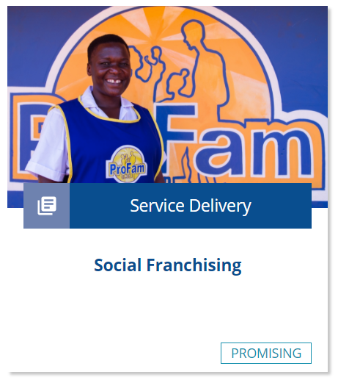

Implementation Tips
Provider Selection and Management
Choose participating health care providers carefully, using a clear accreditation process.
Determine how voucher reimbursements will be used when working with public-sector providers.
Family Planning Vouchers
22
Notes:
Provider Selection and Management
Choose participating health care providers carefully, using a clear accreditation process.
Prior to launching a voucher program, managers should map and assess potential health care providers to ensure the program is geographically accessible to intended beneficiaries and meets quality and managerial requirements.
In addition to meeting standards for quality service delivery and expectations for providing nonjudgmental care to clients, providers must be able to collect, organize, and manage the vouchers they receive to ensure that the voucher management agency can verify services rendered and accurately pay the facility/provider.
Providers will need to consider their own cost and revenue estimates to decide whether to participate in the voucher program.
Program managers must conduct regular monitoring to ensure requirements and standards of the voucher program are upheld.
When providers do not comply with the terms of their voucher agreement, managers typically sanction non-compliant providers early and publicly to encourage other providers to comply.
Partnering with social franchising networks, in which health care providers are typically accredited and operating under clear service requirements, can facilitate the identification and enrollment of qualified providers.
For more information about Social Franchising, please copy and paste this link into your web browser to visit the related HIP Brief: https://www.fphighimpactpractices.org/briefs/social-franchising/
Determine how voucher reimbursements will be used when working with public-sector providers.
Public facilities may not be able to receive direct payments from the voucher management agency for voucher services rendered or decide how to use the revenue for improvements at the facility level; governments must determine how voucher revenue will be used in line with their domestic public financing goals.
For more information about Domestic Public Financing, please copy and paste this link into your web browser to visit the related HIP brief: https://www.fphighimpactpractices.org/briefs/domestic-public-financing/
Public-sector providers may also lack full autonomy to provide services according to the requirements of the voucher program, including the ability to hire additional medical staff or direct resources to facility-level repairs, supply needs, or other improvements.
In Cambodia, the voucher program was able to negotiate with the government to make payments, or a portion of payments, directly to facilities.
In Kenya, some voucher providers in the public sector have been able to invest a growing proportion of their voucher income into improving service quality.

Slide 23
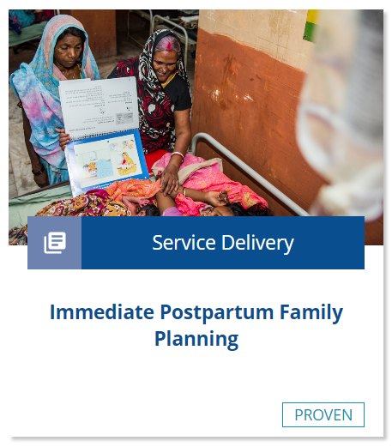
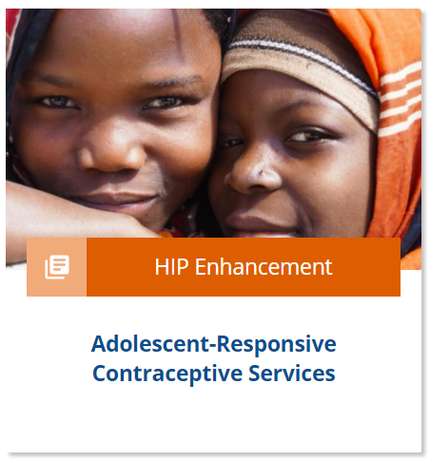
Implementation Tips
Voucher Service Package
Offer a service package that is responsive to client demand.
Include safeguards to ensure voluntary, contraceptive choice.
Family Planning Vouchers
23
Notes:
Voucher Service Package
Offer a service package that is responsive to client demand.
Including a range of services in the voucher program, typically maternity care (immediate postpartum family planning) or STI diagnosis and treatment services, in addition to family planning can facilitate confidentiality and better meet the needs of beneficiaries.
This may be particularly important for adolescents and unmarried women. Counseling, any desired follow-up, and voluntary removals for long-acting reversible contraceptives should be covered in contraceptive voucher services, to ensure client-centered care and avoid prohibitive costs.
For more information about Immediate Postpartum Family Planning, please copy and paste this link into your web browser to visit the related HIP brief: https://www.fphighimpactpractices.org/briefs/immediate-postpartum-family-planning/
For more information about Adolescent-Responsive Contraceptive Services, please copy and paste this link into your web browser to visit the related HIP brief: https://www.fphighimpactpractices.org/briefs/adolescent-responsive-contraceptive-services/
Include safeguards to ensure voluntary, contraceptive choice.
As any program involving financial mechanisms or performance-based incentives, monitoring should be in place so that voucher programs do not inadvertently incentivize inappropriate provider behaviors, such as inflating client numbers or promoting provision of one contraceptive method over another.
If provider reimbursements are differentiated by service or contraceptive method, ensure that rates reflect the time, commodities, and skill level required for that service in order to avoid unintended incentives.
If a voucher aims to increase access to specific methods, such as provider-dependent methods, confirm that other methods are also readily available and that providers support voluntary, client-centered family planning service provision.
Programs should make sure the cost of a voucher is roughly the same as the cost of obtaining another contraceptive and that voucher distribution agents provide other contraceptives or refer clients to the closest service point that offers the method of choice.

Slide 24
Implementation Tips
Voucher System Management
Careful attention should be given to estimating the cost of managing and implementing a voucher program.
Design programs to promote accountability.
Family Planning Vouchers
24
Notes:
Voucher System Management
Careful attention should be given to estimating the cost of managing and implementing a voucher program, including costs for training, accreditation, supervision, administration, and other key inputs.
These costs are highly variable depending on design, size, content, and context of the program.
Examples:
A rural voucher program in Pakistan with private sector social franchise clinics cost approximately US$3.3 million.
Kenya’s safe motherhood and family planning voucher programs were budgeted at 6.5 million Euros between 2006 and 2008.
Design programs to promote accountability.
Voucher management agencies or other voucher governing bodies are charged with putting in place mechanisms to prevent, detect, and manage fraud, should it occur in the program.
The physical record of service provision, in most cases a uniquely numbered paper voucher, simplifies auditing, giving these programs a strong accountability mechanism.
Separation of the voucher management agency function from participating health care providers can increase transparency, allow for independent verification of service delivery, and help curb informal payments.
Results verification and routine voucher data analysis, including tracking trends in vouchers distributed and claims made and use of spot checks, are used to counteract fraud.

Slide 25




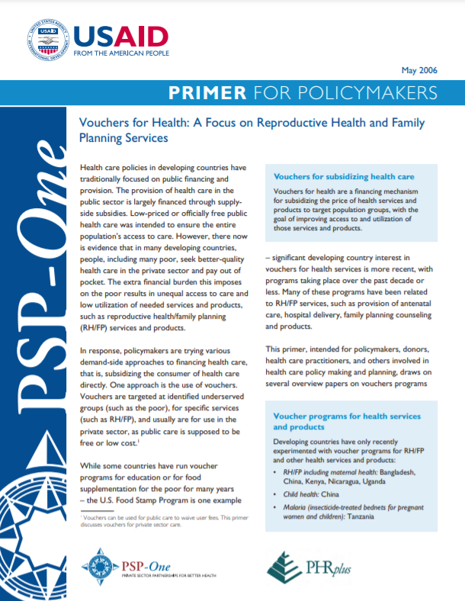
Tools & Resources
A Guide to Competitive Vouchers in Health
E-Vouchers for Family Planning: Advantages, Challenges, and Trends
Reproductive Health Vouchers: From Promise to Practice
Vouchers for Health
05
Family Planning Vouchers
25
Notes:
A Guide to Competitive Vouchers in Health: Identifies the advantages of competitive voucher schemes in delivering subsidies; describes the circumstances under which they are superior to other subsidy mechanisms; and explains how to design, implement, monitor, and evaluate a voucher scheme. http://documents.worldbank.org/curated/en/179801468324054125/A-guide-to-competitive-vouchers-in-health
E-Vouchers for Family Planning: Advantages, Challenges and Trends: Mobile Finance to Reimburse Sexual and Reproductive Health Vouchers in Madagascar: Compares strengths and weaknesses of innovative approaches using digital technology relative to traditional paper voucher initiatives and offers best practices. https://www.shopsplusproject.org/resource-center/e-vouchers-family-planning-advantages-challenges-and-trends
Reproductive Health Vouchers: From Promise to Practice: Presents key implementation lessons drawn from Marie Stopes International’s experience in setting and managing reproductive health voucher programs in various settings. https://healthmarketinnovations.org/sites/default/files/Reproductive%20Health%20 Vouchers%20from%20promise%20to%20practice_0.pdf
Vouchers for Health: A Focus on Reproductive Health and Family Planning Services: Discusses key aspects of voucher programs, elements for assessing the feasibility of a prospective program, and steps for designing and implementing a program where feasible. https://pdf.usaid.gov/pdf_docs/PNADI574.pdf

Slide 26

fphighimpactpractices.org
Notes:
Subscribe to the HIPs Newsletter here (copy and paste this link into your web browser): https://mailchi.mp/76703a3652c9/hips-newsletter-sign-up
Please visit the five areas of our website to learn more about the HIPs:
HIP Products (copy and paste this link into your web browser): https://www.fphighimpactpractices.org/hip-products/
Resources (copy and paste this link into your web browser): https://www.fphighimpactpractices.org/resources/
Engage (copy and paste this link into your web browser): https://www.fphighimpactpractices.org/engage-with-the-hips/
Overview (copy and paste this link into your web browser): https://www.fphighimpactpractices.org/overview/
About Us (copy and paste this link into your web browser): https://www.fphighimpactpractices.org/partnership-structure/

