Slide 1
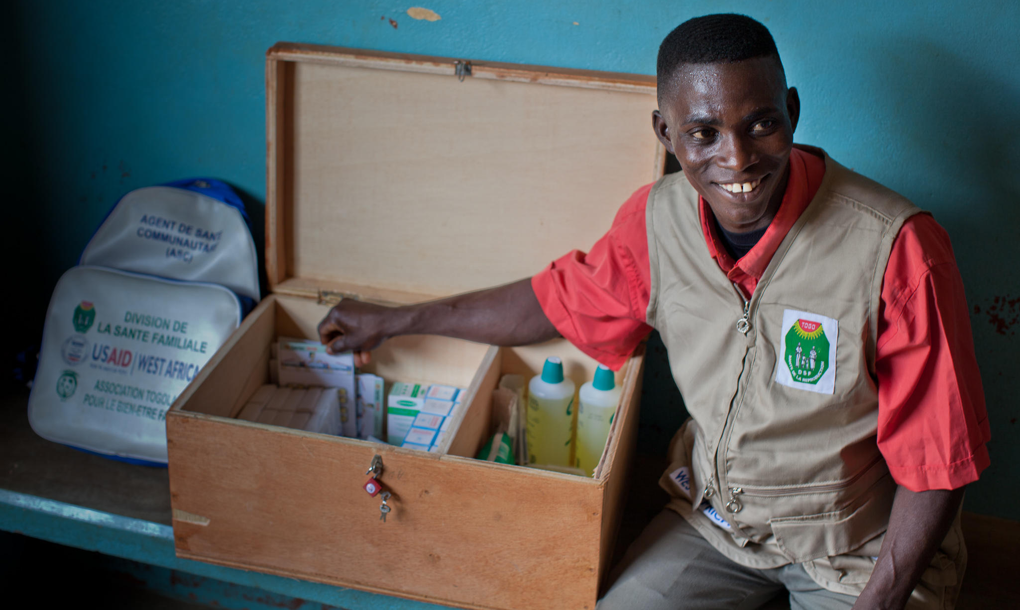



Community Health Workers
Bringing family planning services to where people live and work
Notes:
When appropriately designed and implemented, community health worker (CHW) programs can increase use of contraception, particularly where unmet need is high, access is low, and geographic or social barriers to use of services exist.
© 2012 Katy Doyle, Courtesy of Photoshare
REVISED: 5/4/21

Slide 2
Overview
What is a HIP?
HIP Categories
Partnership
Introduction to the High Impact Practices (HIPs)
PART
PART
Background
Theory of Change
What challenges can CHWs help address?
Evidence of Impact
Community Health Workers (CHWs)
Implementation Tips
Tools & Resources
Extra Slides
11
Community Health Workers
02
Notes:
Thank you for using this slide deck! This is a product derived from the HIP brief to assist you in presenting to a variety of audiences. Instructions and additional resources are included in the notes of each slide for your convenience. There is a wealth of information and resources in the “Notes” section of each slide.
This presentation is divided in three parts: an Introduction to the High Impact Practices (HIPs) in Family Planning, Community Health Workers, and Extra Slides.
The logo for your organization or ministry may be added to these slides. The web addresses provided in the “Notes” section of each slide can be copied and pasted into your web browser.

Slide 3



High Impact Practices in Family Planning (HIPs) are…
Evidence-based family planning practices
Vetted by experts against specific criteria
Documented in an easy-to-use format
Community Health Workers
03
Notes:
High Impact Practices (HIPs) are a set of evidence-based family planning practices vetted by experts against specific criteria and documented in an easy-to-use format.
The High Impact Practices in Family Planning (HIPs) were first created in 2010 after a survey of FP stakeholders revealed little consensus for “what works” in international FP programming. A small group of leaders in FP were brought together with the task of identifying a short list of HIPs that if implemented at scale would help countries address the unmet need for FP and thereby increase national contraceptive prevalence.
HIPs are identified based on demonstrated magnitude of impact on contraceptive use and potential application in a wide range of settings. Consideration is also given to other relevant outcome measures including unintended pregnancy, fertility, or one of the primary proximate determinants of fertility (delay of marriage, birth spacing, or breast feeding). Evidence of replicability, scalability, sustainability, and cost-effectiveness are also considered.
For more information, please copy and paste this link into your web browser to see this video: https://www.youtube.com/watch?v=N6V0gfl-V3k&ab_channel=KnowledgeSUCCESS
A 2-pager overview of the HIPs is available in an online and a downloadable PDF format here (copy and paste this link into your web browser): https://www.fphighimpactpractices.org/high-impact-practices-in-family-planning-list/

Slide 4
HIPs address the full spectrum of FP programming
Enabling Environment
Service Delivery
Social and Behavioral Change
PART
Address systemic barriers that affect an individual’s ability to access family planning information & services. 6 briefs
Improve the availability, accessibility, acceptability, and quality of family planning services. 8 briefs
Influence knowledge, beliefs, behaviors, and social norms associated with family planning.
3 briefs
Enhancements
Approaches used in conjunction with HIPs to maximize the impact of HIP implementation or increase the reach. 4 briefs
Community Health Workers
04
Notes:
There are three categories of HIPs: Enabling Environment, Service Delivery and Social and Behavioral Change. Community Health Workers is a service delivery HIP. This information came from the HIP List (copy and paste this link into your web browser): https://www.fphighimpactpractices.org/high-impact-practices-in-family-planning-list/
A HIP Enhancement is a tool or approach that is not a standalone practice, but it is often used in conjunction with HIPs to maximize the impact of HIP implementation or increase the reach and access for specific audiences. The intended purpose and impact of enhancements are focused and, therefore the evidence-based and impact of an enhancement is subjected to different standards than a HIP.
For more information about the HIP Categories and Enhancements, please copy and paste this link into your web browser: https://www.fphighimpactpractices.org/high-impact-practices-in-family-planning-list/
Here are a few examples of HIPs from each category:
Service Delivery:
Immediate Postpartum Family Planning
Mobile Outreach Services
Postabortion Family Planning
Enabling Environment:
Domestic Public Financing
Educating Girls
Supply Chain Management
Social and Behavior Change:
Community Group Engagement
Digital Health for SBC
Mass Media
Enhancements:
Digital Health for Systems
Adolescent-Friendly Contraceptive Services
Family Planning Vouchers
All HIPs are Available in English, Spanish, French, and Portuguese.

Slide 5





HIP Partnership
The Technical Advisory Group (TAG) is made up of 25 experts in family planning, including representatives from the co-sponsors.
The Co-sponsors include the following organizations:
Community Health Workers
05
Notes:
The High Impact Practices in Family Planning (HIPs) are supported by over 65 organizations. These organizations play a vital role in developing, reviewing, disseminating, and implementing HIPs in family planning.
The HIPs partnership includes various structures to ensure HIP products are developed, kept up to date, and disseminated widely. These include:
Co-sponsors – Serve as the secretariat for the HIPs.
Partners – Contribute to key HIP products and endorse the HIPs.
Technical Advisory Group – Ensure high technical quality of key HIP products and approve HIP brief and SPG concepts for development.
P&D Team – Support the production and dissemination (P&D) of HIP products.
Technical Expert Groups – Write new HIP briefs and ensure they are up-to-date.
For more information about the HIP Partnership, please copy and paste this link into your web browser: https://www.fphighimpactpractices.org/partnership-structure/

Slide 6
High Impact Practice
Integrate trained, equipped, and supported community health workers (CHWs) into the health system.
Community Health Workers
06
Notes:
When appropriately designed and implemented, community health worker (CHW) programs can increase use of contraception, particularly where unmet need is high, access is low, and geographic or social barriers to use of services exist.
For more information about Service Delivery HIPs, please copy and paste this link into your web browser to visit this matrix of tools developed by IBP/WHO: https://www.fphighimpactpractices.org/ibp-who-matrix/
These tools can be used in conjunction with Service Delivery HIPs.
Available in online and downloadable PDF format.
Did you know that we have a webinar recording and downloadable PDF presentation about this HIP? Please copy and paste this link into your web browser to visit: https://www.fphighimpactpractices.org/fr/community-health-workers-high-impact-practices-challenges-and-opportunities-webinar/
This webinar contains recent implementation successes in several country contexts.
Presenters:
Camille Collins Lovell, Facilitator, Pathfinder International
Mahesh Srinivas, Presenter, Pathfinder International
Laura Hurley, Presenter, IntraHealth International
Vince Blaser, Respondent, Frontline Health Workers Coalition

Slide 7
Background
Community health worker (CHW) programs can increase use of contraception, particularly where unmet need is high, access is low, and geographic or social barriers to use of services exist.
CHWs are particularly important to reducing inequities in access to services by bringing information, services, and supplies to women and men in the communities where they live and work.
Community Health Workers
07
Notes:
CHWs “provide health education, referral and follow up, case management, and basic preventive health care and home visiting services to specific communities. They provide support and assistance to individuals and families in navigating the health and social services system” (ILO, 2008).
“…CHWs provide a critical link between their communities and the health and social services system.” – Bhutta et al., 2010
CHWs are referred to by a wide range of titles such as a “village health worker,” “community-based distributor,” “community health aide,” “community health promoter,” “health extension worker,” or “lay health advisor.”
For more information, please copy and paste this link into your web browser to reference the “Background” section on the HIP brief: https://www.fphighimpactpractices.org/briefs/community-health-workers/

Slide 8
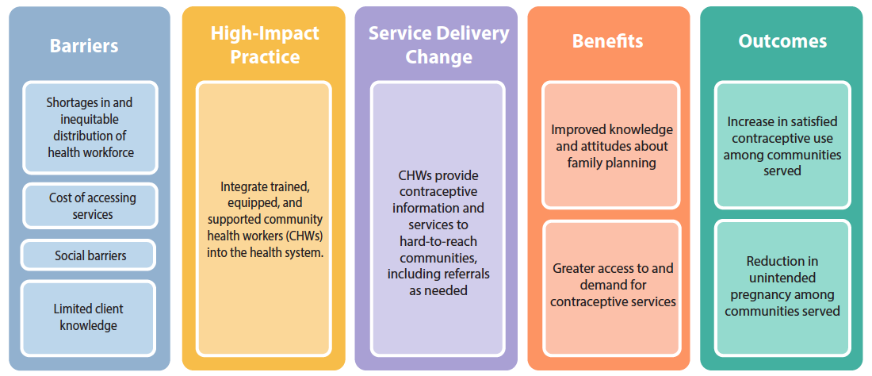
Theory of
Change
BACKGROUND
Community Health Workers
08
Notes:
View Figure 1 in the HIP brief (copy and paste this link into your web browser): https://www.fphighimpactpractices.org/briefs/community-health-workers/

Slide 9
What challenges can CHWs help countries address?
CHWs address geographic access barriers caused by health worker shortages.
CHWs may reduce financial barriers for clients.
CHWs can address the social barriers that inhibit family planning use.
CHWs reach women whose mobility is constrained by social norms.
Community Health Workers
09
Notes:
CHWs address geographic access barriers caused by health worker shortages.
Most highly trained medical staff are concentrated in wealthier, urban areas (WHO, 2006).
“Community health worker programs have emerged as one of the most effective strategies to address human resources for health shortages while improving access to and quality of primary healthcare” (Liu et al., 2011).
CHWs may reduce financial barriers for clients.
Even in settings with “free” services, clients may be asked to pay consultation fees or informal charges before receiving services.
CHWs can address the social barriers that inhibit family planning use.
Women who are young, poor, less educated, or who live in rural areas have more difficulty meeting their family planning needs than their more advantaged counterparts.
These inequities exist in all regions of the world except Central Asia; the gaps are larger and more common in sub-Saharan Africa than in other regions.
Many countries in sub-Saharan Africa demonstrate little or no progress toward reducing the equity gap (Ortayli & Malarcher, 2010; Ross, 2015).
CHWs who come from disenfranchised communities can provide a bridge between individuals and communities and the health system.
CHWs reach women whose mobility is constrained by social norms.
In some countries, cultural practices restrict women’s movement or their ability to make independent decisions.
CHWs overcome such barriers by bringing services to where women and their families work and live.

Slide 10
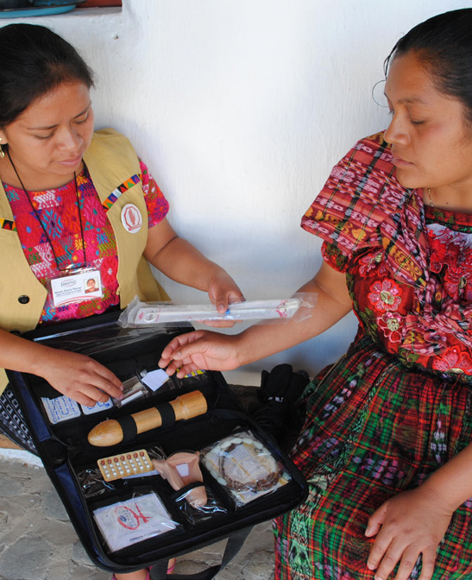
Evidence of Impact
CHW programs may reduce unmet need in countries with large rural populations.
CHWs working in coordination with a functioning health system can reduce fertility rates.
05
Community Health Workers
11
Notes:
CHW programs may reduce unmet need in countries with large rural populations.
Countries such as Bangladesh and Indonesia have strong CHW programs in which CHWs deliver a significant share of modern methods to their communities.
In Bangladesh 23% and in Indonesia 19%, of modern contraceptive users indicate CHWs as their last source of contraceptive supply.
In both these countries, there is also low unmet need for family planning in rural areas (14 and 11%, respectively) (Prata et al., 2005).
CHWs working in coordination with a functioning health system can reduce fertility rates.
In Ghana, in communities where CHWs operated in conjunction with community volunteers, the total fertility rate was reduced by one birth after three years compared with communities with the typical health care system (Phillips et al., 2006).
Bangladesh experienced an estimated 25% reduction in fertility rates over an eight-year period among women who were visited every two weeks by a trained CHW.
Photo Credit: © 2014 Haydee Lemus/PASMO PSI Guatemala, Courtesy of Photoshare

Slide 11

Evidence of Impact
CHWs can expand contraceptive method choice by providing a wide range of methods safely and effectively.
CHWs can also mobilize contraceptive use of clinic-based methods through counseling and referrals.
05
Community Health Workers
11
Notes:
CHWs can expand contraceptive method choice by providing a wide range of methods safely and effectively.
To assist countries in optimizing health worker performance, WHO developed a comprehensive set of evidence-based recommendations to facilitate task sharing for key, effective maternal and newborn interventions, including contraceptive provision (WHO, 2012).
While most CHWs provide condoms and pills within their communities, evidence shows that these workers are also highly effective at providing and referring for other methods (Perry et al., 2014).
For more information, please copy and paste this link into your web browser to visit the HIP brief about task sharing family planning services: https://www.fphighimpactpractices.org/guides/task-sharing-family-planning-services/
CHWs can also mobilize contraceptive use of clinic-based methods through counseling and referrals.
Evidence from Ethiopia demonstrates that, even where CHWs are restricted to providing a limited set of contraceptive methods, they are capable of increasing use of other methods, including long-acting reversible methods, through proper counseling and referrals to clinic-based services.

Slide 12

Evidence of Impact
Cost per Couple-Years of Protection (CYP)¹ by Service Delivery Mode²
SERVICE DELIVERY MODE | AVERAGE COST IN US$ PER CYP (RANGE)
Clinics + CHWs | $9 (1-17)
Clinics | $13 (1-30)
CHWs | $14 (5-19)
Programs that link CHWs with clinic-based service delivery can be cost-effective.
Source: Adapted from Prata et al., 2005; data from Huber & Harvey, 1989.
05
Community Health Workers
12
Notes:
Programs that link CHWs with clinic-based service delivery can be cost-effective.
Cost and cost-effectiveness of CHW programs vary depending on the program setting, worker compensation, maturity of the program, strategies used for training and supervision, and the number of clients served (FRONTIERS et al., 2002).
A review of family planning programs in 10 developing countries found that programs that combined CHWs with clinic-based service delivery were more cost-effective than either clinic-based or CHW programs alone (see Table 1).
¹ CYP is the estimated contraceptive protection provided by contraceptive methods during a one-year period.
² Original analysis was based on community-based distribution (CBD). Reference to CBD has been changed to CHW to maintain consistency with the terminology used in this brief.
View Table 1 in the HIP brief (copy and paste this link into your web browser): https://www.fphighimpactpractices.org/briefs/community-health-workers/

Slide 13

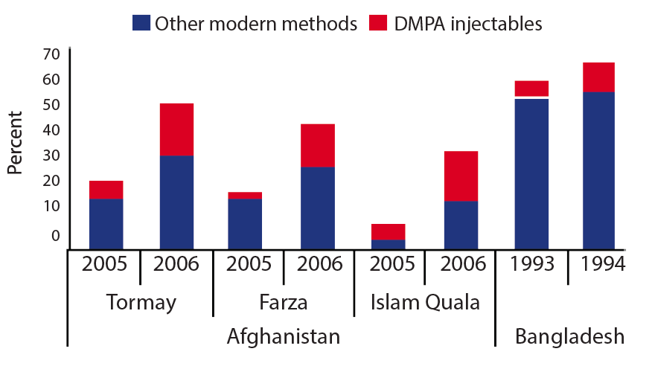
Evidence of Impact
Percent of women using contraception before and after introduction of community-based provision of injectables in selected programs
CHW programs increase contraceptive use in places where use of clinic-based services is not universal.
Source: Malarcher et al., 2011
05
Community Health Workers
13
Notes:
CHW programs increase contraceptive use in places where use of clinic-based services is not universal.
A review of community-based programs in sub-Saharan Africa found six of seven experimental studies demonstrated a significant increase in contraceptive use or reduction in fertility rates (Philips et al., 1999).
In Madagascar, individuals who had direct communication with CHWs were 10 times more likely to use modern contraceptives than individuals who did not have contact with CHWs (Stoebenau & Valente, 2003).
In Afghanistan, a CHW program increased contraceptive usage 24 to 27 percentage points in areas where initial use was very low (beginning at 9% to 24% contraceptive prevalence) (Huber et al., 2010).
Evidence from four programs that introduced community-based provision of injectables into existing CHW programs documented increased uptake of injectables as well as of other modern methods (see Figure 2).
View Figure 2 in the HIP brief (copy and paste this link into your web browser): https://www.fphighimpactpractices.org/briefs/community-health-workers/

Slide 14
Thank You
Continue to the extra slides or access the HIP brief for more information.
Community Health Workers
14
Notes:
For more information, please copy and paste this link into your web browser to visit this webpage with a recording of the webinar on Community Health Workers and a downloadable PDF version of the presentation: https://www.fphighimpactpractices.org/fr/community-health-workers-high-impact-practices-challenges-and-opportunities-webinar/

Slide 15
Extra Slides
Implementation Tips
Tools & Resources
Community Health Workers
15
Notes:
We have put together a collection of implementation tips for community health workers, in case you have additional time in your meeting. Further information about these tips can be found in the HIP brief.
References from the literature on this HIP can be found here (copy and paste this link into your web browser): https://www.fphighimpactpractices.org/wp-content/uploads/2018/08/CommunityHealthWorkers_references.pdf

Slide 16

Implementation Tips
Integrate CHWs Into the Health System
  Link CHWs to the health system with well-defined referral and supervision structures.
  Consider using mobile technology, which may provide a cost-effective approach to link CHWs with the health system.
  Integrate management information systems.
Community Health Workers
16
Notes:
Integrate CHWs Into the Health System
Link CHWs to the health system with well-defined referral and supervision structures.
In Ethiopia, CHWs receive regular supervision by supervisors who are linked to health facilities.
In Madagascar, CHWs report monthly to the head provider of the health center and receive supportive supervision.
Consider using mobile technology, which may provide a cost-effective approach to link CHWs with the health system.
A program in Malawi supported SMS communication to improve information sharing between CHWs and their district teams.
The most frequent SMS communication was regarding commodity stock-outs, which ultimately resulted in stock-out reductions.
For more information about this technology, please copy and paste this link into your web browser to visit the Digital Health for Systems HIP Brief: https://www.fphighimpactpractices.org/briefs/digital-health-systems/
Integrate management information systems.
In Ethiopia, CHWs began keeping a “family folder” for every family in the catchment area of a health post.
Health cards were organized in wooden boxes according to the month in which follow-up services were needed for family members.
If a health card was left in the previous month’s box, it alerted the health worker that a service had not been provided, prompting the health worker to reach out to the family to provide care.

Slide 17
Implementation Tips
Train CHWs.
  Implement a comprehensive training program that includes incremental, practical, and competency-based training and mechanisms to reinforce skills.
  Expand the variety of methods provided by CHWs.
  Train and engage CHWs in behavior change communication efforts.
Community Health Workers
17
Notes:
Train CHWs.
Implement a comprehensive training program that includes incremental, practical, and competency-based training and mechanisms to reinforce skills.
In Madagascar, more education, weekly volunteer hours, and refresher training were associated with higher performance scores among CHWs providing family planning services.
Expand the variety of methods provided by CHWs.
When contraceptive services are provided directly by CHWs, uptake is significantly greater than when CHWs offer referrals only.
Train and engage CHWs in behavior change communication efforts.
In India, women living in communities where CHWs supported a behavior change communication campaign focused on healthy timing and spacing of pregnancy were 3.5 times more likely to be using modern contraception at 9 months postpartum than women living in communities where CHWs were not involved in this communication campaign.

Slide 18
Implementation Tips
Equip CHWs.
  Invest attention and funding to improve supply chains all the way to CHWs.
  Make appropriate and timely community logistics data visible at both the health center and the district level.
  Implement multilevel quality improvement teams that connect CHWs, health center staff, and district staff.
Community Health Workers
18
Notes:
Equip CHWs.
Success of CHW programs is directly linked to continuous product availability at the community level. Supply chains are optimal when data and product flow between CHWs and the larger health system are in sync.
Invest attention and funding to improve supply chains all the way to CHWs.
Consider organizational capacity, CHW literacy levels, ways to track logistics management information systems forms, and ways to track and aggregate data.
CHWs should be included in the design and integration of supply chain infrastructures.
For more information, please copy and paste this link into your web browser to visit the Supply Chain Management HIP brief: https://www.fphighimpactpractices.org/briefs/supply-chain-management/
Make appropriate and timely community logistics data visible at both the health center and the district level.
Implementing an SMS and web-based mHealth system, where data are transformed into relevant, useable reports, can significantly improve timely and accurate availability and usability of community health logistics data at all levels of the supply chain.
Implement multilevel quality improvement teams that connect CHWs, health center staff, and district staff.
Such teams were associated with significantly improved product availability in Ethiopia, Malawi and Rwanda (Chandani et al., 2014).

Slide 19
Implementation Tips
Support CHWs.
  Employ incentives to retain CHWs.
  Certify CHWs to visibly recognize their contributions.
  Engage communities in planning, monitoring, and supporting CHWs.
Community Health Workers
19
Notes:
Support CHWs.
Employ incentives to retain CHWs.
Incentives, both financial and non-financial, were associated with greater retention among volunteer CHWs in urban Dhaka (Alam et al., 2012).
In many countries, CHWs are paid, full-time members of community health systems.
Certify CHWs to visibly recognize their contributions.
Certification helps to professionalize the community health workforce, driving quality standards for training and performance.
Engage communities in planning, monitoring, and supporting CHWs.
In Madagascar’s successful national CHW program, CHWs are supervised by the Community Health Committee.

Slide 20

Implementation Tips
Support CHWs.
  Recruit CHWs from the beneficiary communities.
  Consider recruiting men as CHWs.
  Be dynamic and evolve with changing needs.
Community Health Workers
20
Notes:
Support CHWs.
Recruit CHWs from the beneficiary communities.
Studies consistently show that CHWs reach women of similar ages and household socioeconomic status to their own.
Programs that aim to serve disadvantaged communities will need to recruit, train, and support CHWs from these communities.
Consider recruiting men as CHWs.
Men have great potential in increasing distribution of male condoms, which provide dual protection against both unwanted pregnancy and sexually transmitted infections (STIs), including HIV. Evidence shows that male CHWs distribute more condoms than female CHWs.
Male CHWs also appear to serve more male clients.
For more information about engaging men, please copy and paste this link into your web browser to visit the HIP strategic planning guide on Engaging Men and Boys in Family Planning: https://www.fphighimpactpractices.org/guides/engaging-men-and-boys-in-family-planning/
Be dynamic and evolve with changing needs.
Community-based programs are most effective when they evolve with the changing needs of the communities they serve.

Slide 21


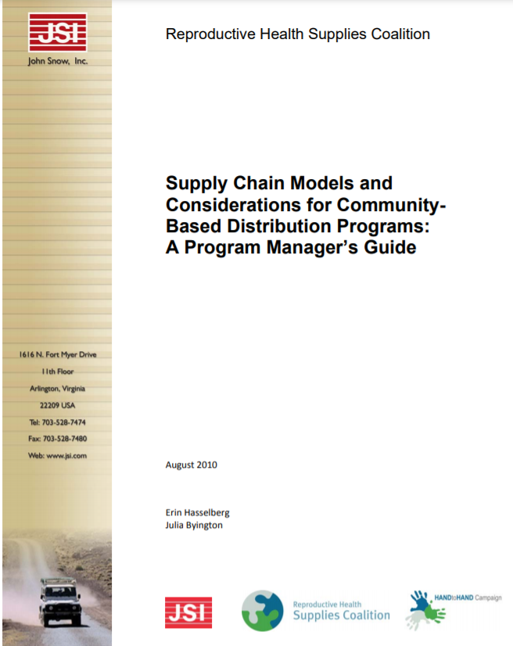
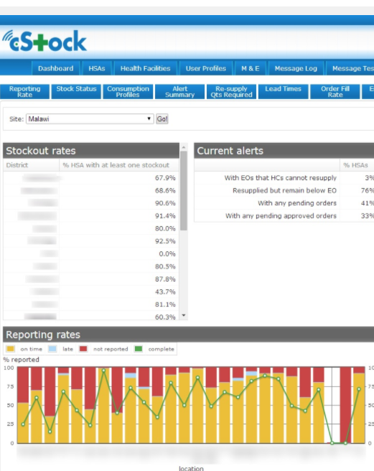
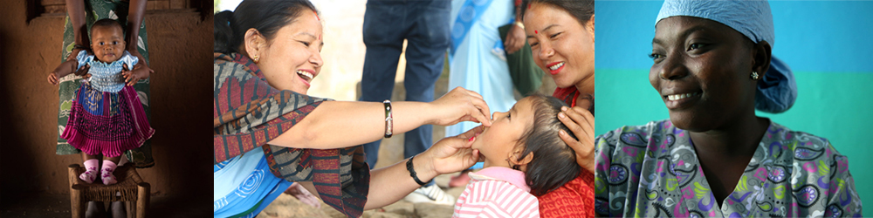
Tools & Resources
Supply Chain Models and Considerations for Community-Based Distribution Programs: A Program Manager’s Guide
The Community-Based Family Planning Toolkit
cStock
Community Health Systems Catalog
05
Community Health Workers
21
Notes:
The Community-Based Family Planning Toolkit, is a one-stop source for knowledge and lessons learned about community-based family planning programs. Available from: https://toolkits.knowledgesuccess.org/toolkits/communitybasedfp
Supply Chain Models and Considerations for Community-Based Distribution Programs: A Program Manager’s Guide, presents four supply chain models for community-based programs with guidance and lessons learned on supply chain functions that can be adapted and applied to a variety of country contexts. Available from: https://publications.jsi.com/JSIInternet/Inc/Common/_download_pub.cfm?id=11132&lid=3
cStock, a RapidSMS, open-source, Web-accessible logistics information management system, helps CHWs and health centers streamline reporting and resupply of up to 19 health products, including contraceptives, managed at the community level while enhancing communication and coordination between CHWs, health centers, and districts. Learn more at: http://sc4ccm.jsi.com/emerging-lessons/cstock/
Community Health Systems Catalog, is an interactive Web-based reference tool on community health systems, including structure, management, staffing, and services, in a number of countries. Available from: https://www.advancingpartners.org/resources/chsc
Bonus resource: Use of the WHO Guidelines & Tools alongside service delivery High Impact Practices in family planning. The tool focuses on Service Delivery HIPs and selected WHO Guidelines related to family planning service delivery. The tool is intended to be a quick reference for program managers designing or implementing family planning programs. The tool can be used to help improve implementation of HIPs by illustrating how to incorporate WHO evidence-based guidelines and/or can be used to support advocacy efforts for HIPs by linking them with globally recognized and credible WHO Guidelines. Please copy and paste this link into your web browser to visit: https://www.fphighimpactpractices.org/ibp-who-matrix/

Slide 22

fphighimpactpractices.org
Notes:
Subscribe to the HIPs Newsletter here (copy and paste this link into your web browser): https://mailchi.mp/76703a3652c9/hips-newsletter-sign-up
Please visit the five areas of our website to learn more about the HIPs:
HIP Products (copy and paste this link into your web browser): https://www.fphighimpactpractices.org/hip-products/
Resources (copy and paste this link into your web browser): https://www.fphighimpactpractices.org/resources/
Engage (copy and paste this link into your web browser): https://www.fphighimpactpractices.org/engage-with-the-hips/
Overview (copy and paste this link into your web browser): https://www.fphighimpactpractices.org/overview/
About Us (copy and paste this link into your web browser): https://www.fphighimpactpractices.org/partnership-structure/

